Slide 1



www.nouhata.fi/en

Slide 2
LESSON 2:
WHAT TO DO IN CASE OF FIRE
Notes:
NouHätä! lesson 1:
Preventing fires
The next slide lists the learning objectives of this lesson.

Slide 3
LESSON 2:
WHAT TO DO IN CASE OF FIRE
After this lesson, you…
01
…know which fire extinguisher to use.
02
...can describe how to rescue yourself and others in different types of fire.
Notes:
Go through the learning objectives of the lesson.
Next theme to study:
1. Choosing the right fire extinguisher.

Slide 4
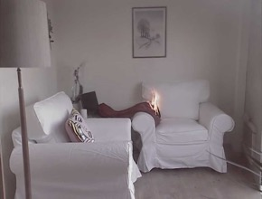
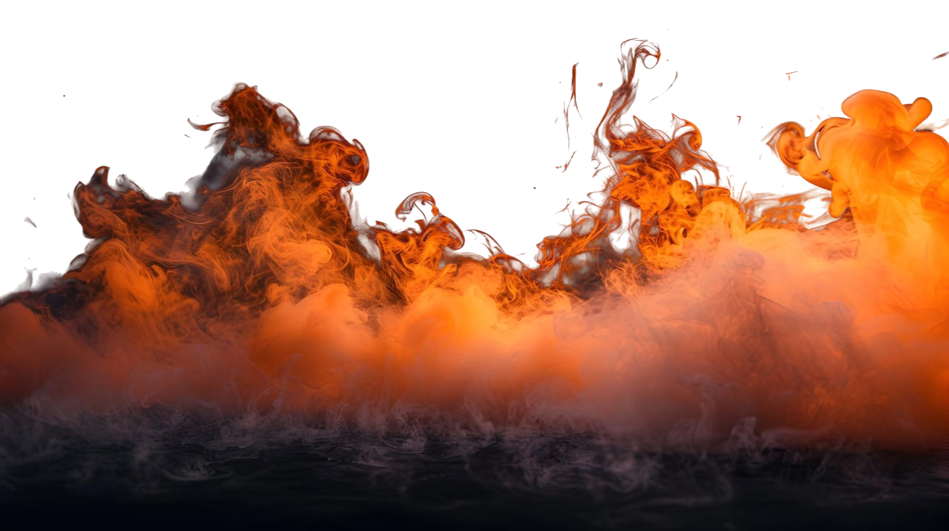

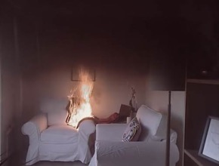
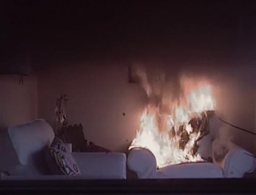
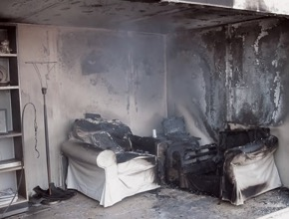
In a fire, the air becomes life-threatening in just minutes
1 to 2 minutes
If a fire starts:
If you detect the fire as soon as it starts, it is easier to
put out.
A minute after the fire has started:
A nearby smoke alarm detects the fire.
After a few minutes:
Putting out the fire is no longer possible on your own.
By now, the room has plenty of toxic fire gases that are extremely dangerous to inhale.
2 to 3 minutes
3 to 4 minutes
  © Räddningstjänsten Syd
Notes:
The times shown in the slide are examples. In the real world, how fast the fire spreads depends on how the fire started, the material that burns and the surrounding environment. Fires can vary greatly in how they behave.
A fire may spread quickly, which is why important to know what to do and how to stay safe.

Slide 5

Watch out for smoke!
Smoke from a fire is toxic.
Smoke also makes it harder to see.
The temperature of smoke can be as high as 700 degrees.
In the event of a fire:
Don’t enter a room that has smoke. If you are in a room that has smoke, crawl to safety.
Avoid inhaling smoke.
Close the door if possible to prevent the fire
and smoke from spreading.
Why is it important to crawl at floor level if there is smoke in the room?
Poisoning from burning gases and carbon monoxide is the most
common cause of death from a fire.
Notes:
A fire becomes lethally toxic fast and early, at the stage when the fire has spread to just a small area of the room, such as the sofa cushions. Gases released from burning furniture are very toxic. Toxic gases are absorbed into the bloodstream when breathing in and replace oxygen. At worst, breathing toxic fire gases can cause a person to die on the spot.
If there is smoke in the staircase, stay inside the apartment and keep the door closed. Go near a window or on the balcony, call for help and make yourself visible.
Question:
Why is it important to crawl at floor level if there is smoke in the room?
Answer: Smoke always rises, so there is breathable air for longer below the smoke and heat. When a fire is blazing, the temperature can be 700 degrees at shoulder height and only 100 degrees at knee height. A rug or a thick wool blanket, for example, can protect against heat. Crawling on all fours makes you less exposed to smoke and heat.
However, keep in mind that crawling on all four doesn’t protect from carbon monoxide poisoning. Carbon monoxide (CO) is a gaseous, odourless and colourless compound of carbon and oxygen. Carbon monoxide is produced by incomplete combustion, for example in an oil stove or car exhaust. It is a highly dangerous gas that affects the body quickly and unnoticeably, causing unconsciousness even at low concentrations. Carbon monoxide poisoning can lead to serious injuries or even death.

Slide 6

Notes:
Watch the video on how to use a handheld fire extinguisher and fire hydrant. The video will start automatically. English subtitles available on video.

Slide 7
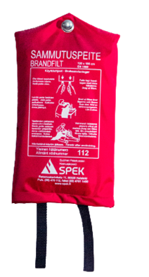
What to do if...
IMPORTANT!
Never throw water on burning oil or grease, as
this will cause the fire to explode and splatter!
grease, oil or stearin catches fire?
  Suppress the fire with a lid or a fire blanket.
  Turn off the cooker hood and cooktop.
  If possible, carefully move the pot away from the cooktop.
Notes:
Stearin fires should also be put out by smothering with a blanket or with a hand-held fire extinguisher.

Slide 8

Using water to put out a grease fire will cause the fire to explode
Notes:
Watch a video on what happens when trying to put out a grease fire with water. The video will start automatically. The video needs an internet connection.
https://www.youtube.com/watch?v=d8Ohj8O_sSw&feature=youtu.be
It is important to stress that trying to put out a grease fire with water causes the fire to explode Throwing water on burning grease causes the fire to explode and splatter.
Question:
Why does water cause a grease fire to explode?
Because water is heavier than oil or grease, it will sink through the grease. When water reaches its boiling point, it evaporates and quickly expands, causing the burning grease to explode and splatter. Grease burns hard when it has access to oxygen.

Slide 9
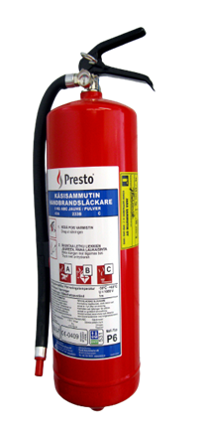
What to do if...
a flammable liquid such as gasoline catches fire?
  Put out the fire with a hand-held fire extinguisher or by smothering.
Notes:
Flammable substances include gasoline, oil, varnish, paint and liquid petroleum gas, among others
The extinguishing agent shoots from the extinguisher with force, so hold the end of the hose to direct the extinguishing agent as close to the flames as possible.

Slide 10
What to do if...
an electrical appliance catches fire?
  Unplug the appliance from the outlet if you can do so safely.
  Next, putout the fire with a fire blanket and/or a hand-held extinguisher.
  IMPORTANT! Putting out a fire with water has its risks!
Notes:
If an electrical appliance catches fire, the first thing to do is to unplug the appliance from power before water can be safely used to put out the fire. If the appliance has not been unplugged from power, do not use water to put out the fire!Otherwise, there is a risk of electric shock.

Slide 11
What to do if...
a solid material catches fire?
  Wood, paper, plastic and fabric fires are best put out with water or the nearest hand-held extinguisher.
  Furniture fires and solid materials on fire can also be suppressed with a fire blanket.

Slide 12
What to do if...
…your clothes catch fire?
  Protect your face, get down on the ground and roll.
  If possible, wrap yourself in a fire blanket, carpet or similar item or use water to put out the fire.
…someone else's clothes catch fire?
  Tell the person to protect their face and get down on the ground.
  Put out the fire with a fire blanket or similar item from top to bottom, head to toes. You can also use water to put out the fire.
Notes:
A fire blanket works by smothering the fire to starve it from oxygen. Cover the entire area on fire with the fire blanket to smother and extinguish the fire. Unlike fire extinguishers, suppressing a fire with a fire blanket does not harm the environment.

Slide 13
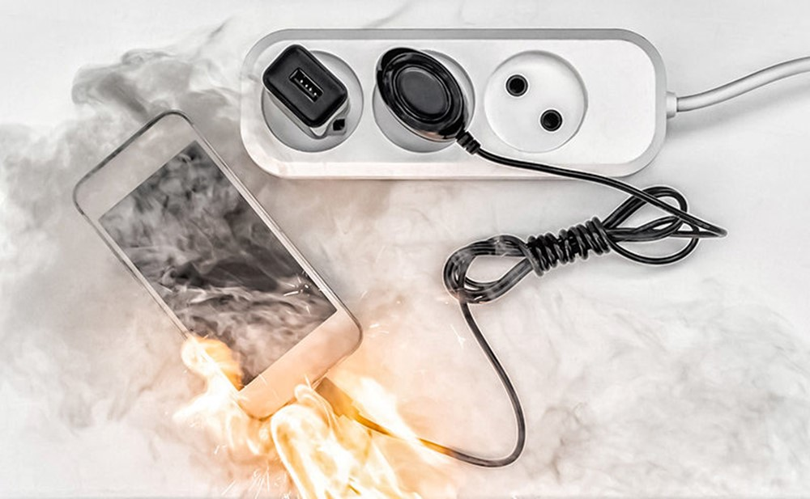
What to do if...
a battery is smouldering?
  Unplug the appliance from the power outlet.
  Submerge the appliance in water if you can do so safely.
Batteries burn explosively and are difficult to switch off!
…a battery is burning with a visible flame?
  Unplug the appliance from power.
  Leave the room, close the door and call 112.
A battery fire produces very toxic burning gases.
Avoid inhaling them!
Notes:
A battery is smouldering:
Try unplugging the power cord or turning off the main power switch (if the appliance is plugged in and you can safely unplug it).
Cool the heated battery with a large amount of water. Submerge the appliance in water.
A battery is burning with a visible flame:
Unplug the power cord if necessary and if you can do so without injuring yourself.
Leave the room, call 112 and follow instructions.
Remember that the battery can re-ignite after the fire has been put out.

Slide 14
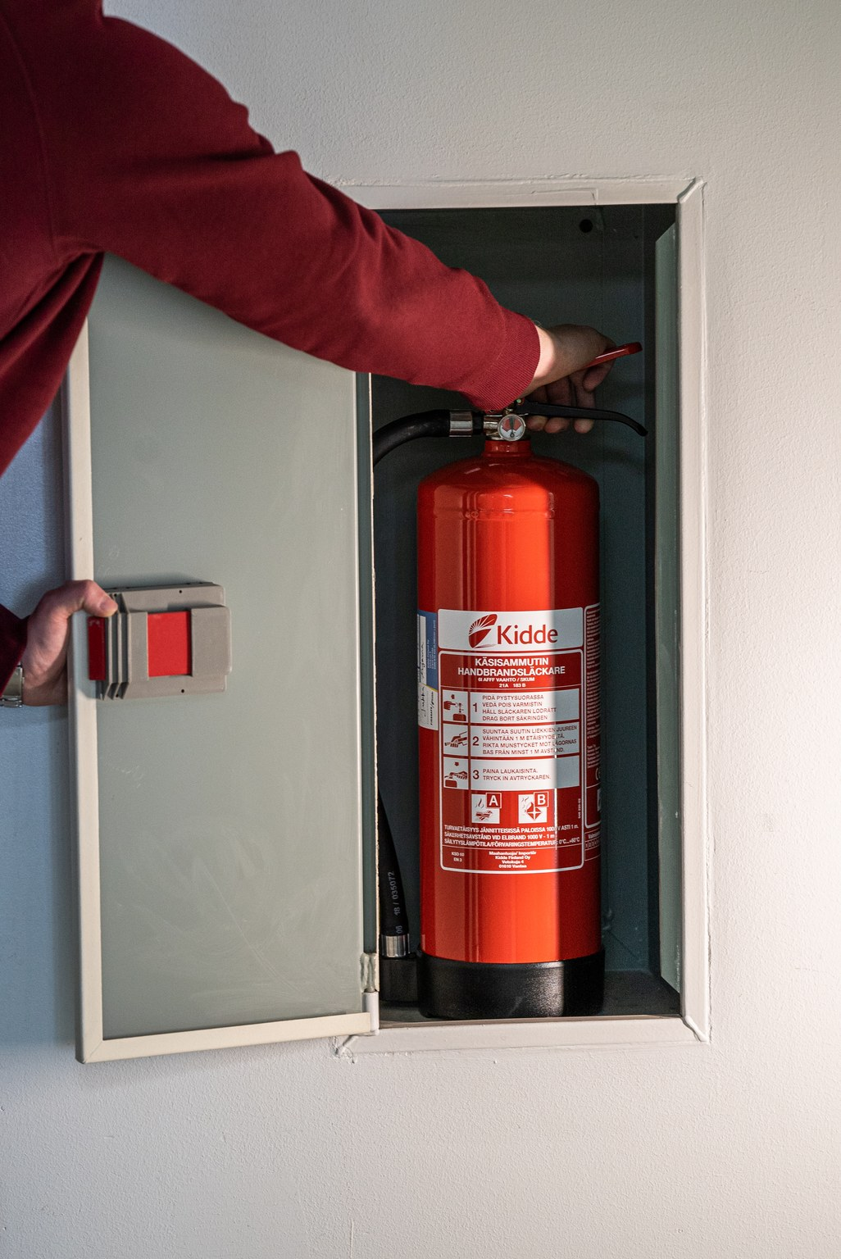
Fire extinguishers in schools
Find out
where the fire extinguishers in your school are located.

Slide 15
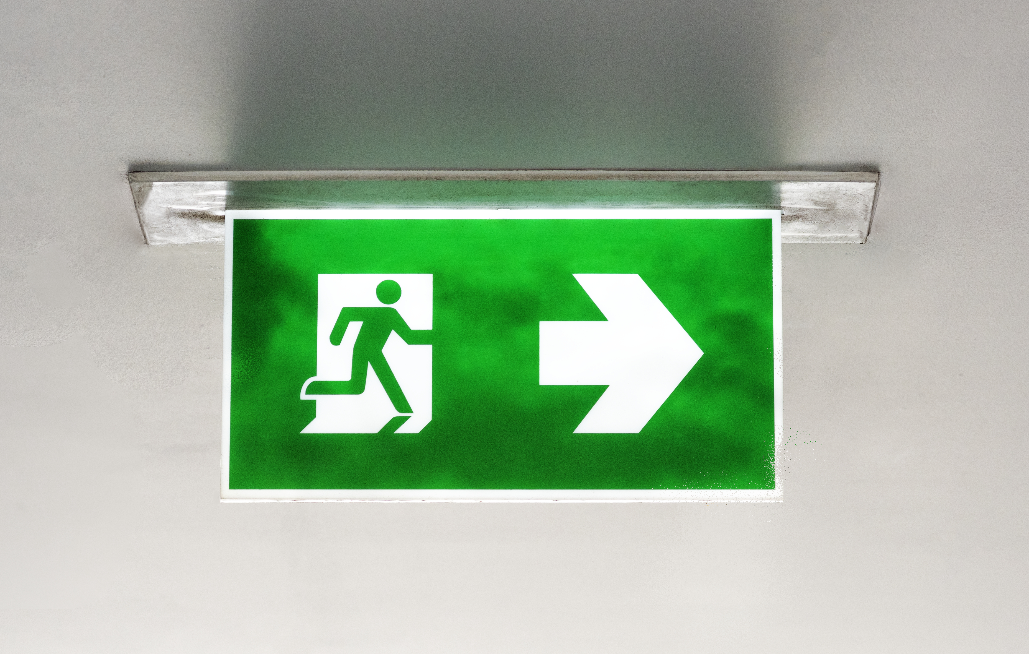
Evacuation routes
All buildings must have at least two evacuation routes - including your own home.
At home, the other evacuation route can be a window or balcony from where you can be rescued by the fire brigade.
Prepare for fires by planning your escape routes and practicing regularly.
Notes:
Even if you’re familiar with your home’s layout of rooms and where the furniture are located, it can be a whole different situation when the rooms are filled with smoke and you can see little or nothing at all. That’s why it’s also important to keep the home clean and the floors clear of clutter to potentially trip over.

Slide 16
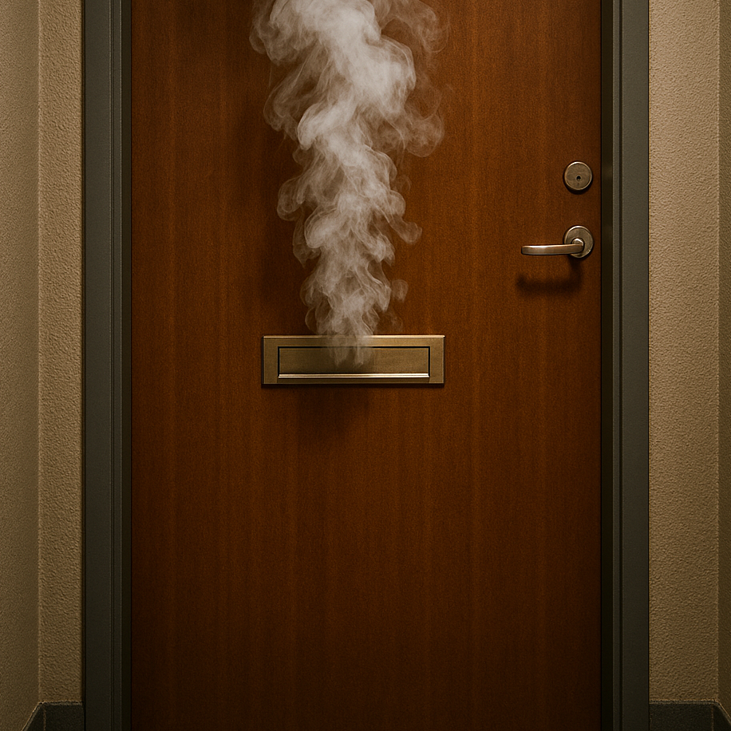
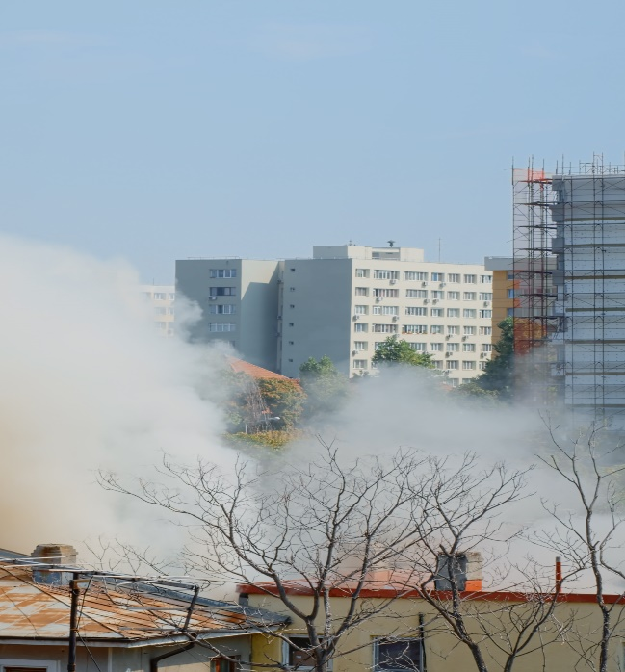
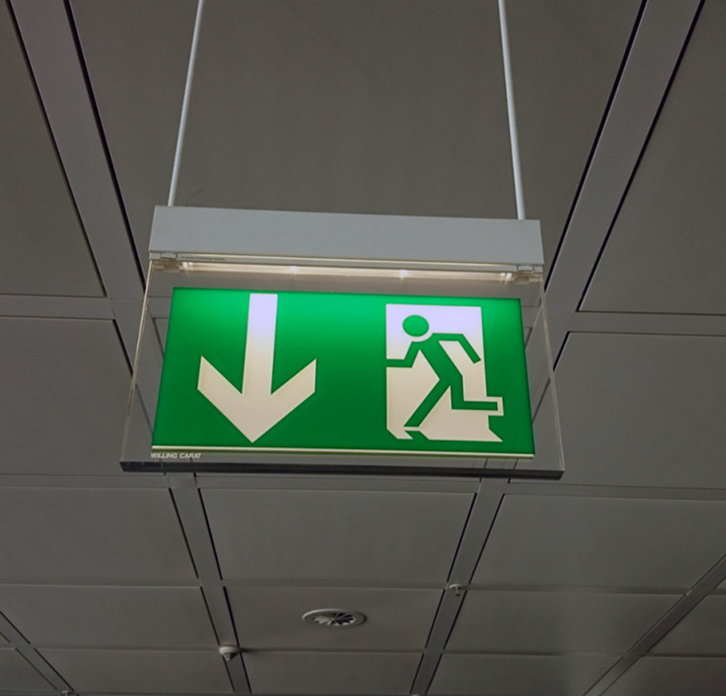
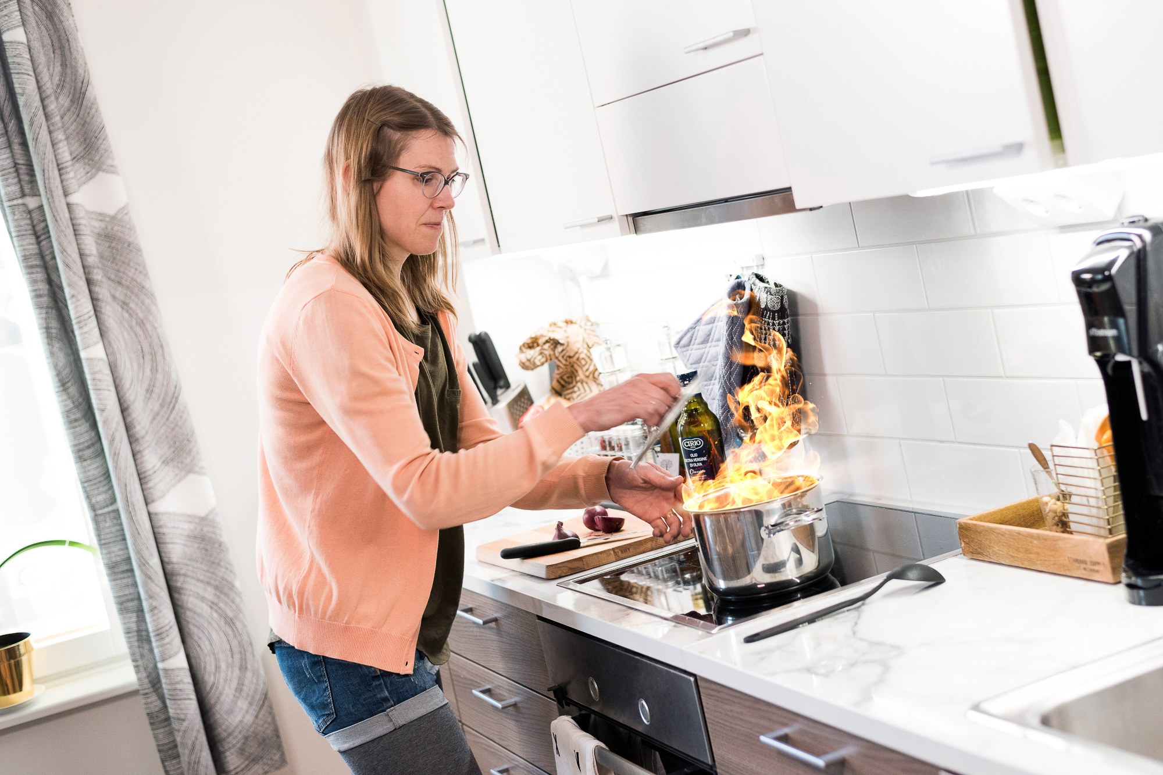
How to protect yourself depends on the situation.
Fire in your home
Fire in another apartment
in the building
Fire in the neighbourhood
Fire in a public space
Notes:
If putting out the fire is not possible, you need to protect yourself from the fire. How to protect yourself depends on the situation.
This section discusses what to do in the event of fire in different environments.
In the next example, a fire has broken out in your own home.

Slide 17
If a fire breaks out in your home, leave your home
Fire in your home
PUT OUT the fire if it is safe to do so.
WARN others in the home.
LEAVE the burning building or apartment. Do not use the elevator!
  Close doors and windows behind you.
  Warn others in danger and help them evacuate.
  Go to the assembly point.
Call 112 from a safe place.
GUIDE the rescue services to the site.
Notes:
When you hear the smoke alarm, it’s important to act fast as you won’t have much time to warn others and evacuate.
If you hear the smoke alarm in the apartment you are in, shout to warn those in danger and wake up anyone who may be sleeping.
If the fire is still small, you can try to put it out with a fire blanket or hand-held extinguisher. Don’t put yourself in danger.
If the fire is not put out in about 30 seconds, leave the room and close the door.
Leave the building or apartment quickly and help others evacuate. Close all windows and the front door behind you. If you are in an apartment building and there is no smoke in the staircase, warn the neighbours by ringing their doorbells, for example. Remember to exit using the staircase. Do not use the elevator!
Go to the assembly point.
Call 112 from a safe place. Guide the fire brigade to the location.

Slide 18
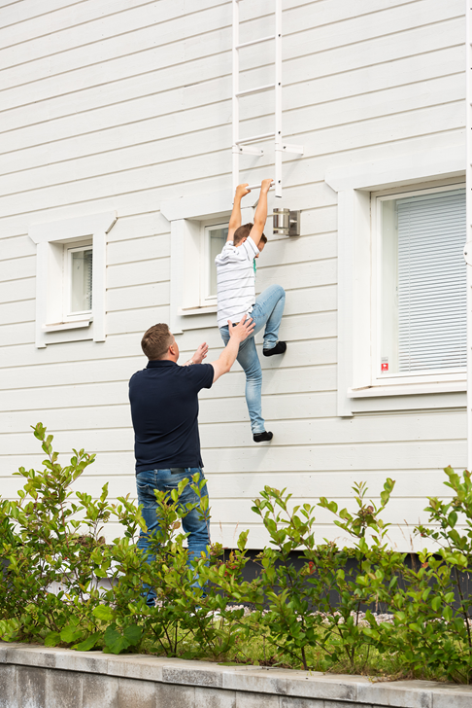
If there was a fire in your home and the front door was blocked, how would you evacuate?
Notes:
Answer: All buildings and apartments must have at least two evacuation routes. One of these is the normal exit and the other an emergency exit, such as a balcony or window.

Slide 19
How to protect yourself depends on the situation.
Fire in your home
Fire in another
apartment in the building
Fire in the neighbourhood
Fire in a public space
Notes:
If putting out the fire is not possible, you need to protect yourself from the fire. How to protect yourself depends on the situation.
This section discusses what to do in the event of fire in different environments.
In the next example, a fire has broken out elsewhere in your apartment building.

Slide 20

There is a fire elsewhere in the apartment building and smoke in the staircase. What do you do?
Play the game at
bit.ly/fire-corridor
or read the QR code to open the game.
Notes:
Link to the game: https://spek.h5p.com/content/1291662006953165597
Important! If you hear a smoke alarm in another apartment and there is no smoke in the staircase, you can first find out if you can see smoke or flames in the apartment. If not, you can try knocking on the door or windows to try to contact the person inside and find out what is going on. If you don’t hear from anyone or you can see smoke or flames in the apartment, call 112 immediately. If necessary, keep knocking on the door or windows and ring the doorbell to try to wake up people who might be sleeping in the apartment. Don't risk exposing yourself to smoke!

Slide 21
If there is a fire elsewhere in your apartment building,
stay in your home
STAY INSIDE your apartment.
Don’t enter the staircase or areas with smoke.
CLOSE the connecting doors in the hallway.
CALL 112.
SEAL the gaps in the door with a wet towel and tape over the gaps in the letterbox if smoke enters the apartment.
MOVE to an open window or balcony
if smoke is still entering the apartment. Call 112.
Notes:
If there is a fire in a neighbouring apartment or staircase of your building
In an apartment building, each apartment is a separate fire compartment. Fire compartments prevent the fire and burning gases from spreading to other apartments.
That’s why the safest thing to do is to stay in your apartment. It is life-threatening to enter a staircase that is filled with smoke.
It is important to remember that if the fire is in another apartment in the building, the best course of action is to stay in your apartment.
Close the doors and seal any gaps in the door with a wet towel so that smoke cannot enter your apartment.

Slide 22
How to protect yourself depends on the situation.
Fire in your home
Fire in another
in the building
Fire in the neighbourhood
Fire in a public space
Notes:
If putting out the fire is not possible, you need to protect yourself from the fire. How to protect yourself depends on the situation.
In the next example, there is a fire in the neighbourhood, such as a nearby building.

Slide 23

What should you do in case of fire in the neighbourhood?
Play the game at bit.ly/tulipalo2
or go to the game by reading the QR code.
Notes:
Link to the game: https://spek.h5p.com/content/1291662036853467267

Slide 24
If there is a fire in the neighbourhood,
stay inside your home
If you are notified about a fire in the neighbourhood, don’t go out to the scene
of the fire.
If smoke enters the home, close the windows and turn off ventilation if necessary.
Follow the instructions of the authorities in the 112 mobile app, for example.
If necessary, shelter indoors.
Notes:
There may be toxic burning gases outside, and you could interfere with the work of rescuers.
If it becomes dangerous to stay in your home due to smoke entering the building, call 112 to ask for help.

Slide 25
How to protect yourself depends on the situation.
Fire in your home
Fire in another apartment
in the building
Fire in the neighbourhood
Fire in a public space
Notes:
If putting out the fire is not possible, you need to protect yourself from the fire. How to protect yourself depends on the situation.
In the next example, you are in a public space such as a shopping centre when you hear the fire alarm.

Slide 26
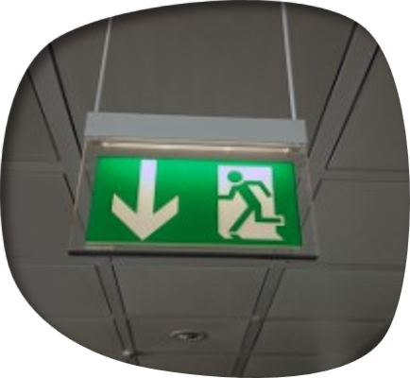
If a fire breaks out in a public space, follow the instructions you are given
Don’t approach the smoke.
Stay calm and move quickly,
but don’t run.
Use marked exit routes.
Go to the assembly point.
Notes:
There is a fire in a school or shopping centre, for example.

Slide 27
Can you find the exit sign
in your classroom?
Do you know at least
two ways out
of the school?

Slide 28
REVISION
LESSON 2:
WHAT TO DO IN CASE OF FIRE
Notes:
Review the main content of the lesson.

Slide 29

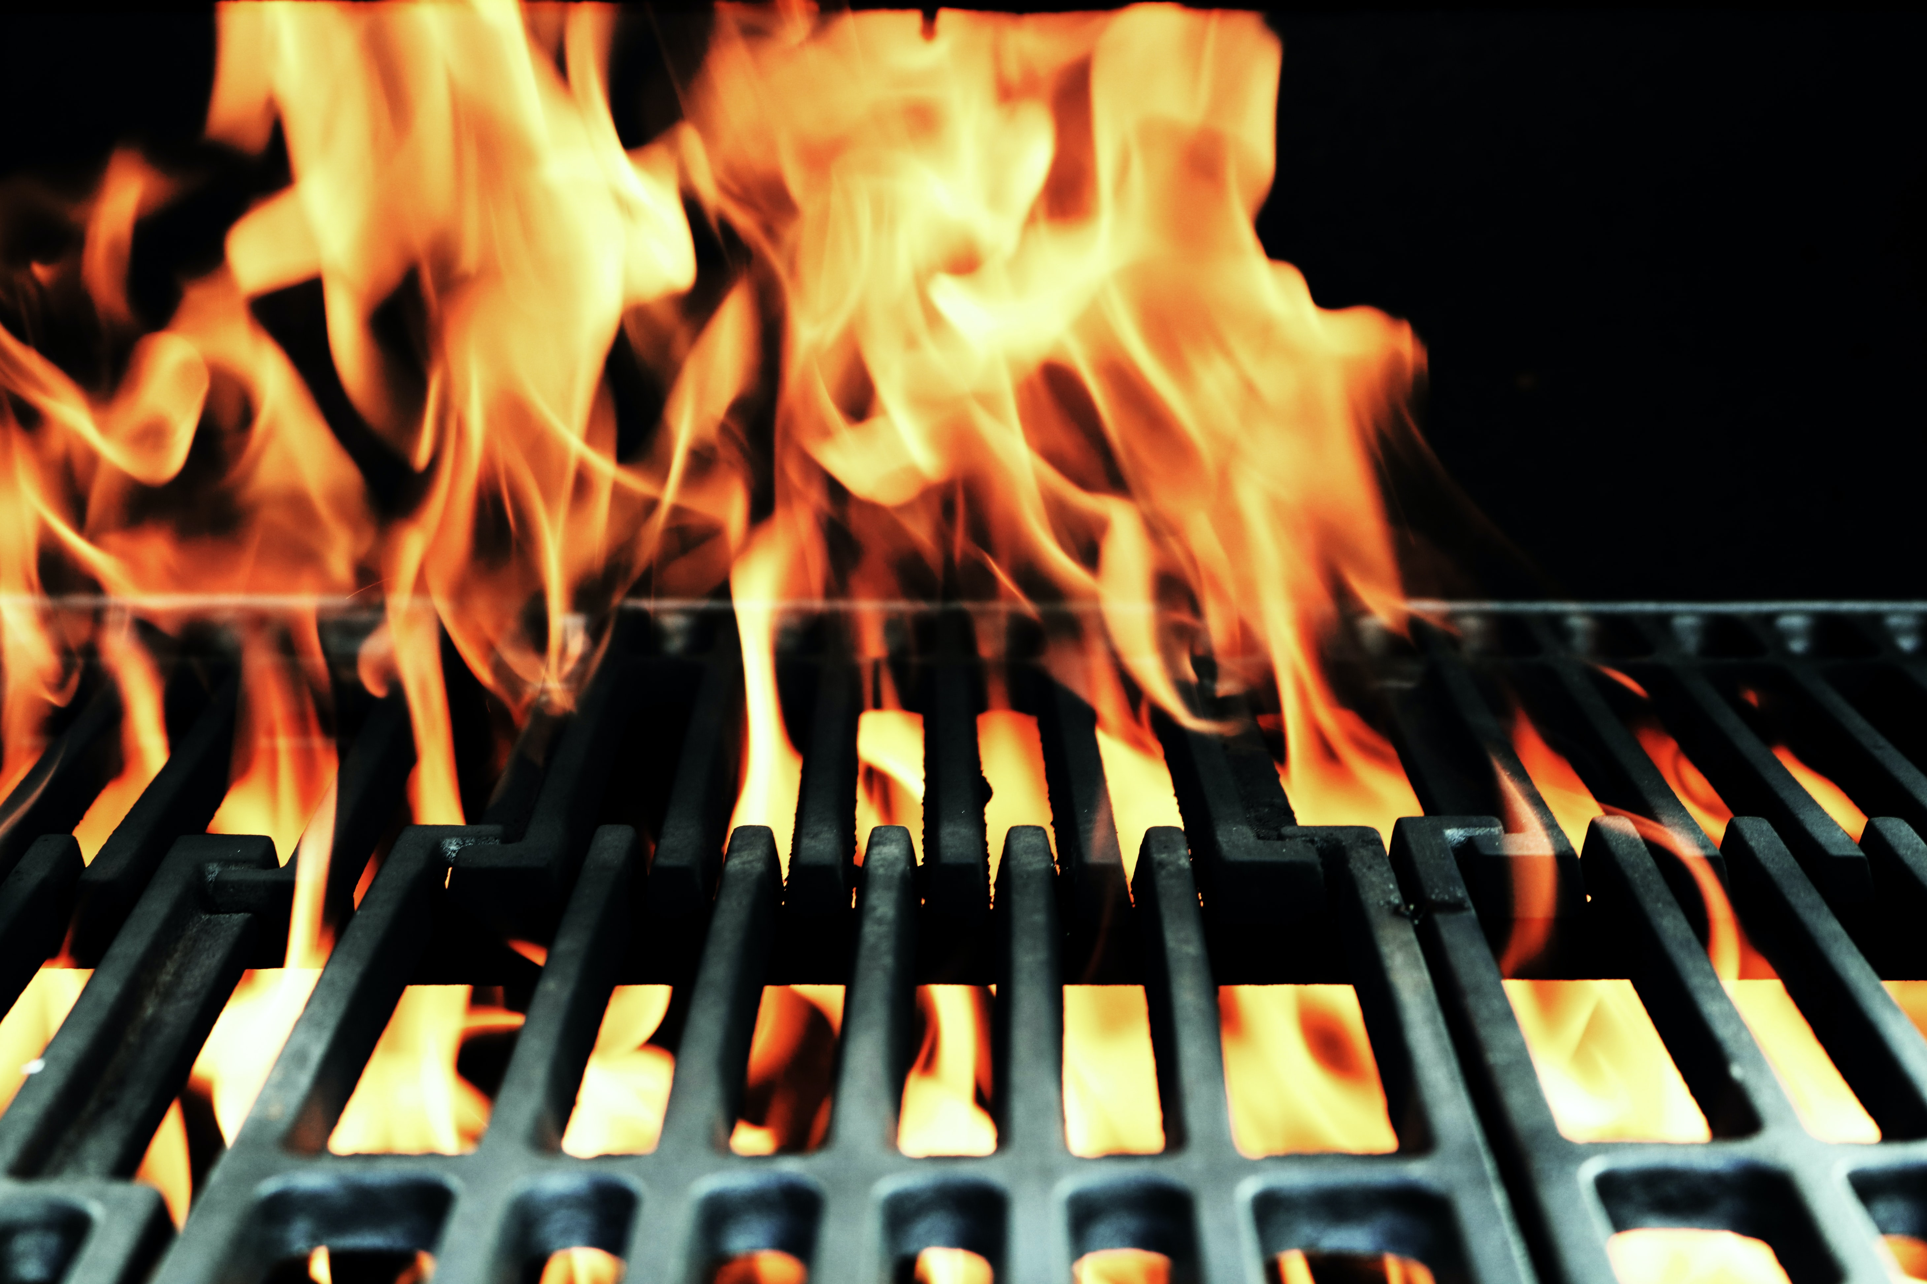
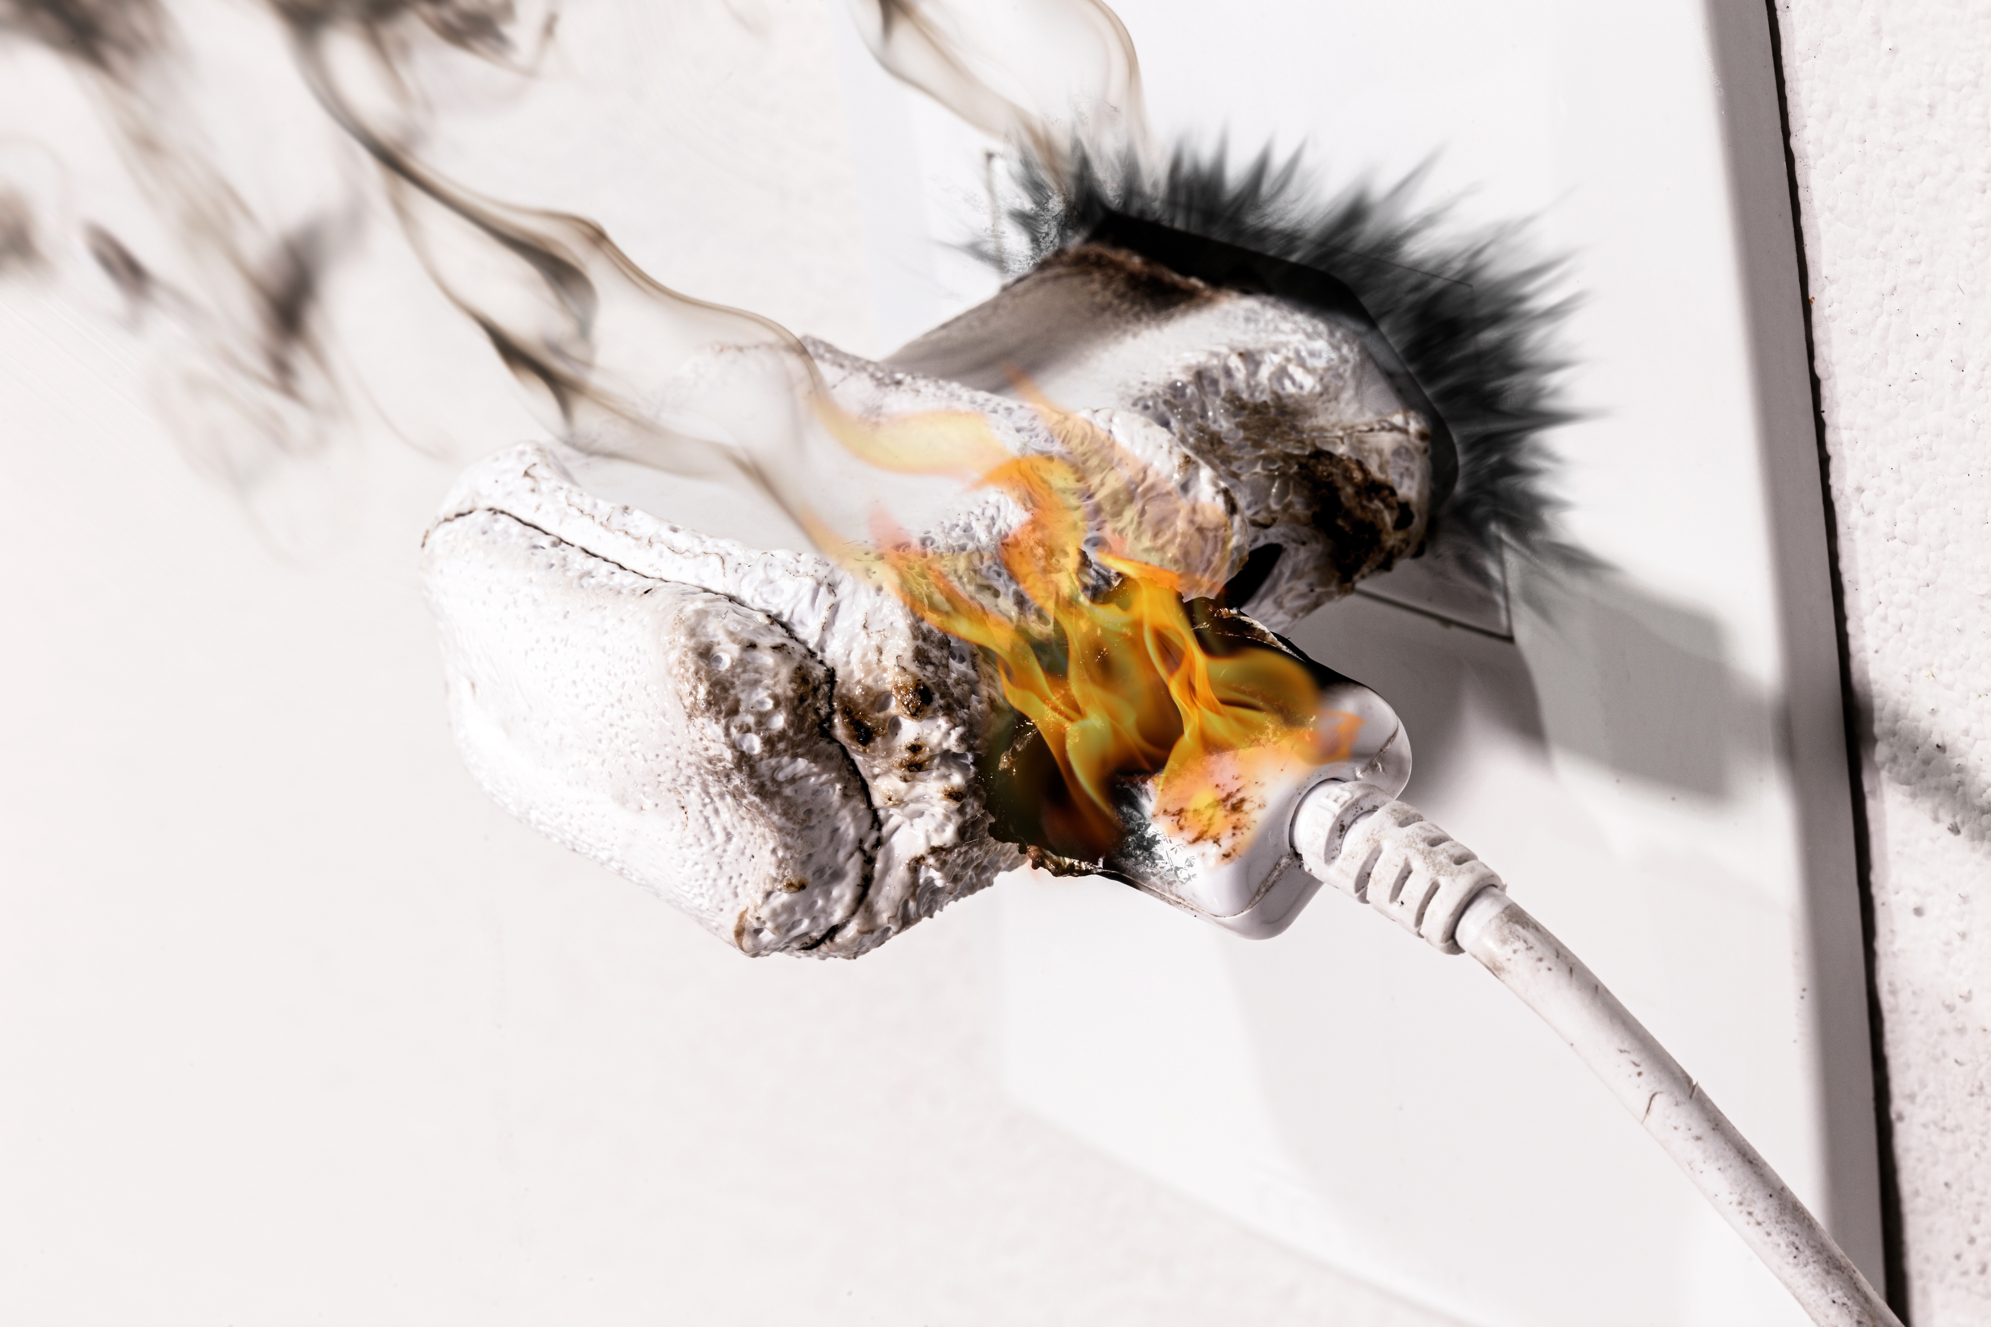
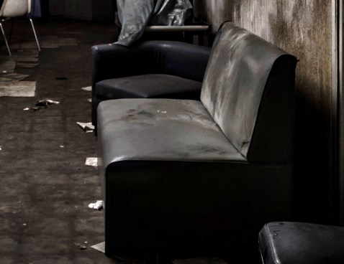
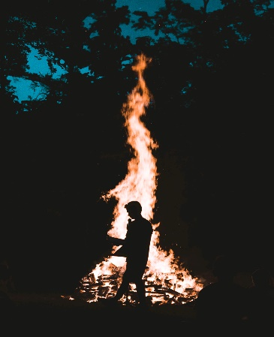
The learning objective has been achieved:
1. You know how to choose the right extinguisher.
Type of fire | Hand-held extinguisher | Fire blanket | Water
Oil, petrol
Electrical equipment
Furniture
Battery
Clothing
1. Choose the right fire extinguisher
Notes:
IMPORTANT! If an electrical appliance catches fire, the first thing to do is to unplug the appliance from power before water can be safely used to put out the fire. If the appliance has not been unplugged from power, do not use water to put out the fire!Otherwise, there is a risk of electric shock.
This exercise can be found in the printable materials if you want to share it with your students.

Slide 30

Should I
evacuate or stay inside if:
…there is a fire in the apartment or house:
…there is a fire elsewhere in the apartment building:
…there is a fire in the neighbourhood:
…there is a fire in a public space:
Leave the house or apartment..
Stay in the house or apartment..
Stay in the house or apartment.
Evacuate according to instructions.
The learning objective has been achieved:
2. You know how to protect yourself in different fires.
Notes:
This exercise can be found in the printable materials if you want to share it with your students.
Instructions
Remember the instructions in different situations.
It is especially important to stay in your own apartment if there is a fire elsewhere in the apartment building.
There is a fire in your home:
PUT OUT the fire if it is safe to do so.
WARN others in the home.
EXIT the burning apartment. Do not use the elevator!
Close doors and windows behind you.
Warn others in danger and help them evacuate.
Go to the assembly point.
Call 112 from a safe place.
GUIDE the rescue services to the location.
Fire elsewhere in the apartment building:
STAY INSIDE your apartment. Do not enter the hallway or a space with smoke.
CLOSE the connecting doors in the hallway.
CALL 112.
SEAL the gaps in the door with a wet towel and tape over the gaps in the letterbox if smoke enters the apartment.
MOVE to an open window or balcony
if smoke is still entering the apartment. Call 112.
Fire in the neighbourhood: Stay in your home. If necessary, shelter indoors.
If you are notified about a fire in the neighbourhood, don’t go out to the scene of the fire.
If smoke enters the home, close the windows and turn off ventilation if necessary.
Follow the instructions of the authorities in the 112 mobile app, for example.
If necessary, shelter indoors.
Fire in a public space: follow the instructions and signs.
Don’t approach the smoke.
Stay calm and move quickly, but don’t run.
Use the marked exit routes.
Go to the assembly point.

Slide 31
www.nouhata.fi/en

