Slide 1



www.nouhata.fi/en

Slide 2
LESSON 3:
ACCIDENTS AND INJURIES
Notes:
NouHätä lesson 3:
Accidents and injuries
The next slide lists the learning objectives of this lesson.

Slide 3
LESSON 3:
ACCIDENTS AND INJURIES
After this lesson, you…
01
…can identify risks of accident.
02
…know how to prevent accidents.
03
...can describe what to do in an accident.
Notes:
Go through the learning objectives of the lesson.
Next theme to study: 1. Identifying risks of accident

Slide 4

Accidents in Finland
Have you ever been in an accident?
How many accidents take place in Finland every year?
How many accidents take place in Finland every day?
Around 1,500,000
Around 4,100
Notes:
Nearly 1,500,000 accidents each year
About 1,500,000 accidents happen in Finland every year, or about 4,100 every day. Many of these accidents are preventable.
Source: https://www.kotitapaturma.fi/app/uploads/2024/03/Turvallisia-vuosia-opas.pdf
Over the past two decades, Finland has become a safer place to live by many metrics. This is the result of long-term, systematic efforts to improve safety. Despite this positive trend, the total number of accidents has gone up. This is caused by an increase in accidents in homes and on leisure time. Accidents are one of the biggest national health problems when comparing the costs and frequency of accidents with other types of health problems. (Source: Haikonen, K. & kump., 2017, Suomalaiset tapaturmien uhreina – kansallisen uhritutkimuksen tuloksia [Victims of accidental injuries in Finland 2017. Results from the national victimisation survey]. National Institute for Health and Welfare.)
There are around one million children aged 0 to 14 in Finland, and accidents cause around 100,000 visits to the doctor and 10,000 visits to the hospital every year. https://tervekoululainen.fi/ylakoulu/tapaturmat/lasten-ja-nuorten-tapaturmat/

Slide 5
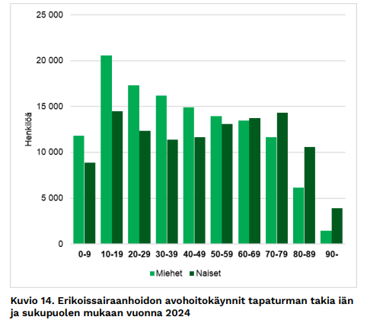
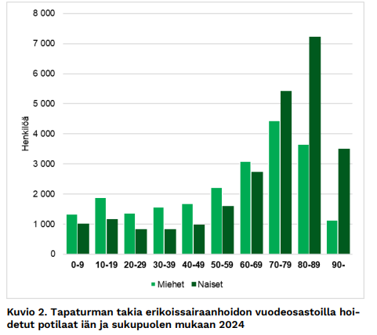
Accident statistics (2024)
What can you see in the graphs?
Persons
Persons
Men
Women
Men
Women
Specialized health care outpatient visits for injuries by age and gender, 2024.
Inpatients treated for injuries in specialized health care by age and gender, 2024.
Notes:
The most common types of accidents among children and young people (age under 25) that require hospital treatment are trip and fall injuries and sports injuries. Road accidents are also common among young people.On average, 12,900 people under the age of 25 are hospitalised as the result of an accident every year.
Source:
https://julkaisut.valtioneuvosto.fi/bitstream/handle/10024/162537/STM_2020_33_j.pdf?sequence=4&isAllowed=y
https://www.julkari.fi/bitstream/handle/10024/151686/tr_42_2025.pdf?sequence=1&isAllowed=y

Slide 6

Emergency services
Notes:
English subtitles available on video

Slide 7
Emergency response centre
If you're unsure whether to make an emergency call to 112 - MAKE THE CALL! The emergency response centre will assess the situation for you.
The emergency response centre will also give instructions in the situation, so you don’t need to worry about not knowing what to do.
The sooner you call, the sooner help can arrive!

Slide 8

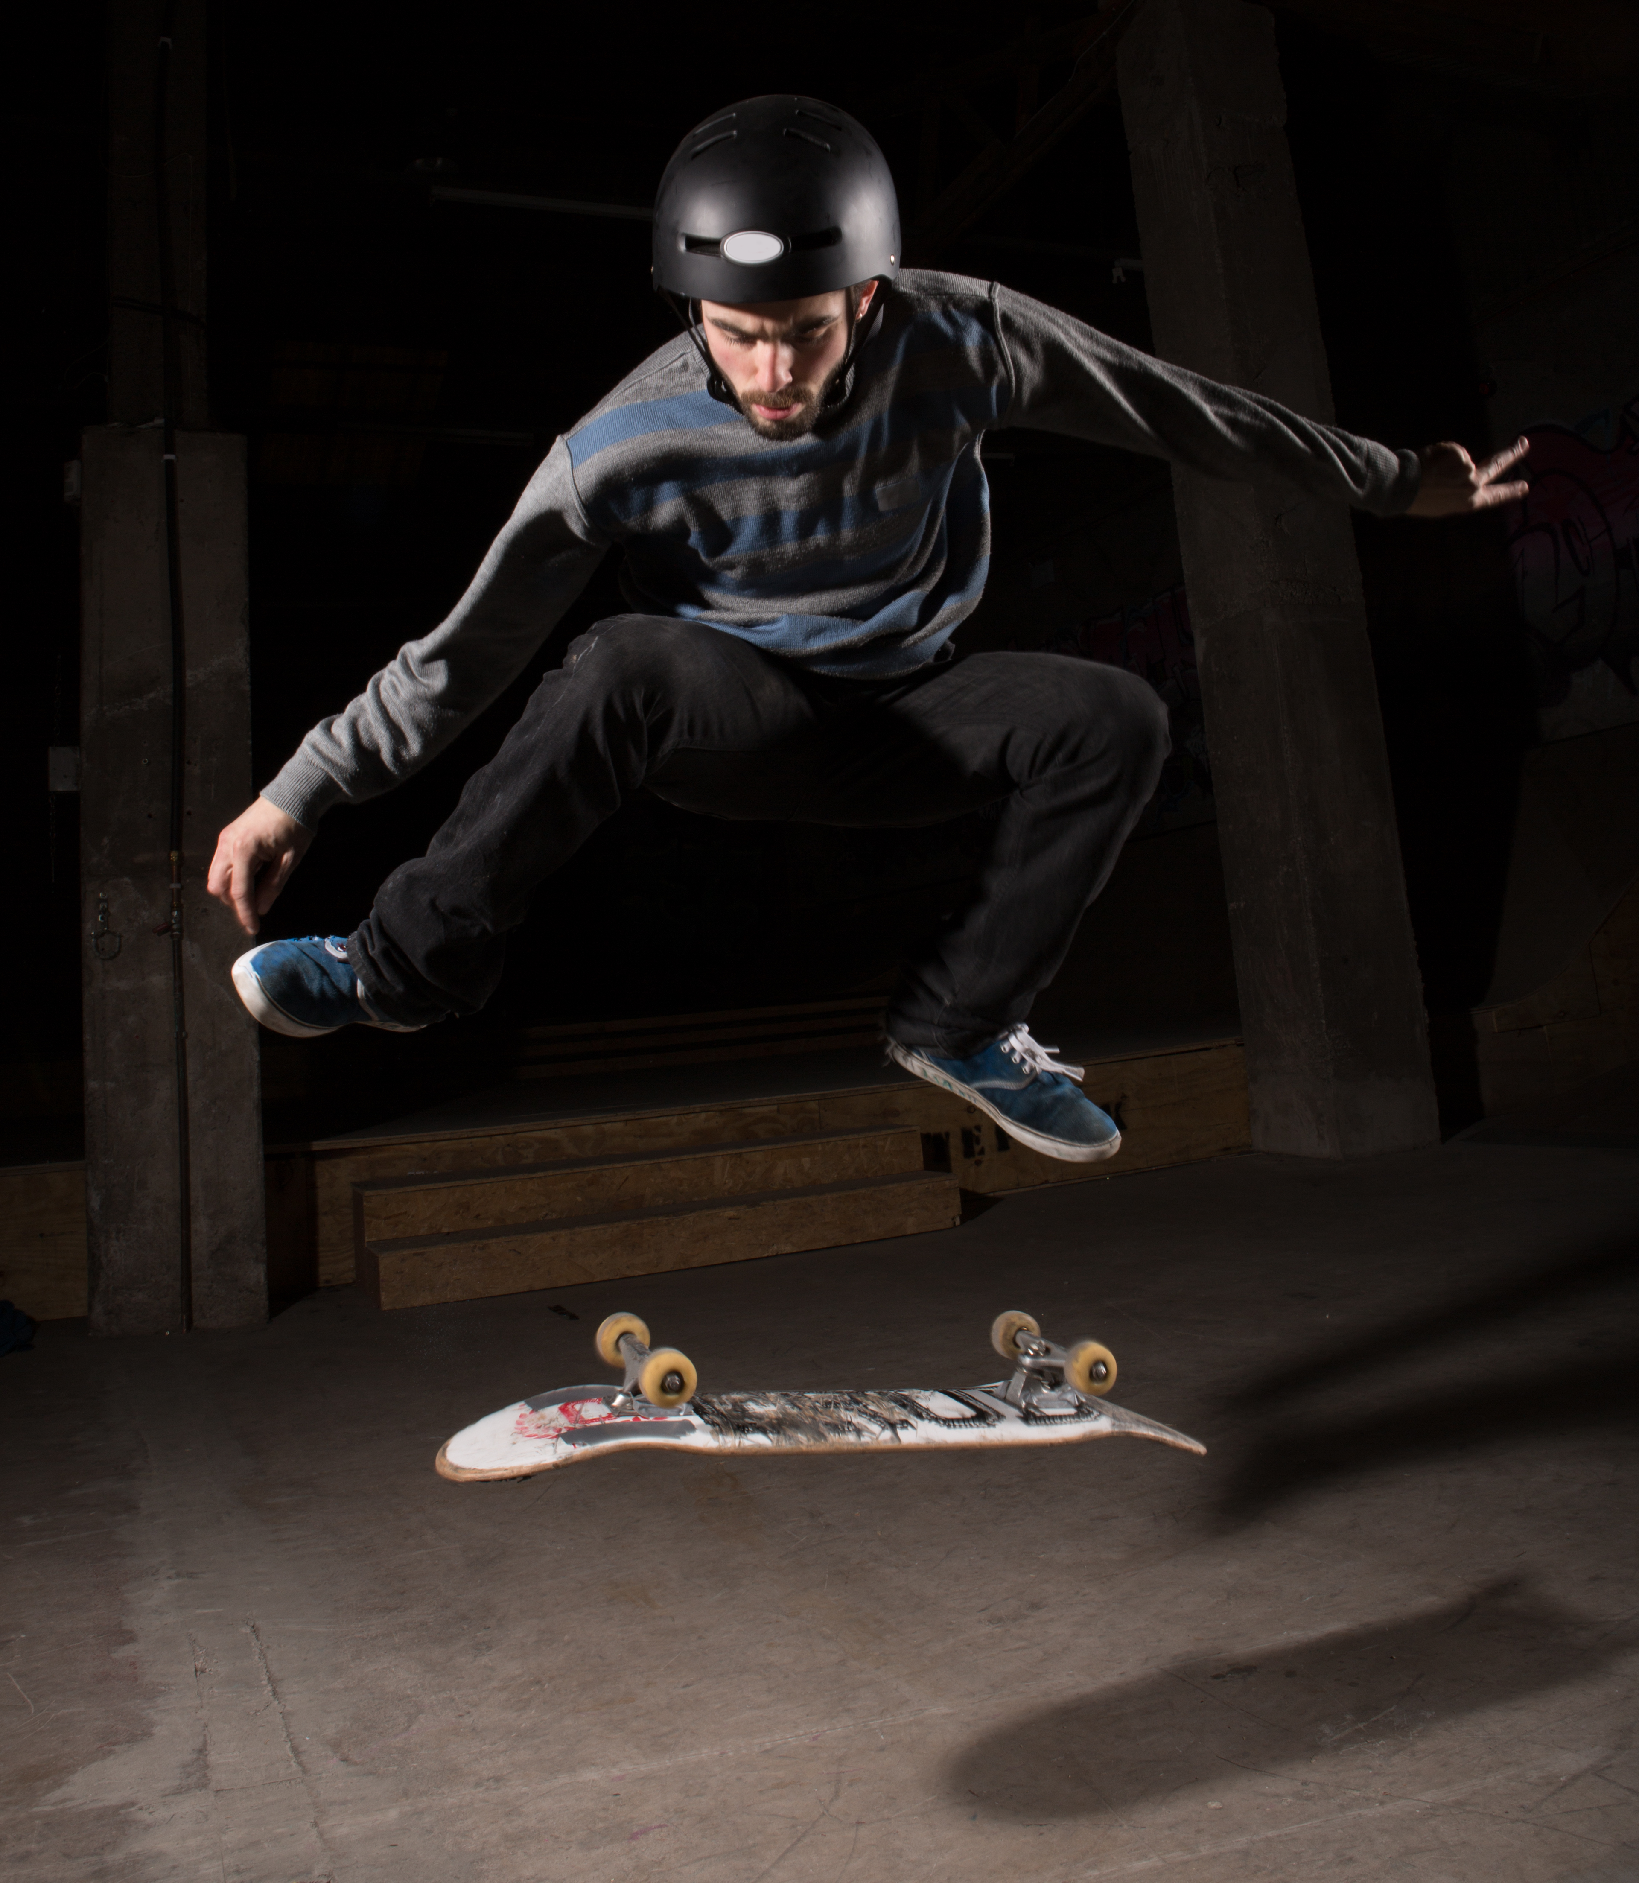
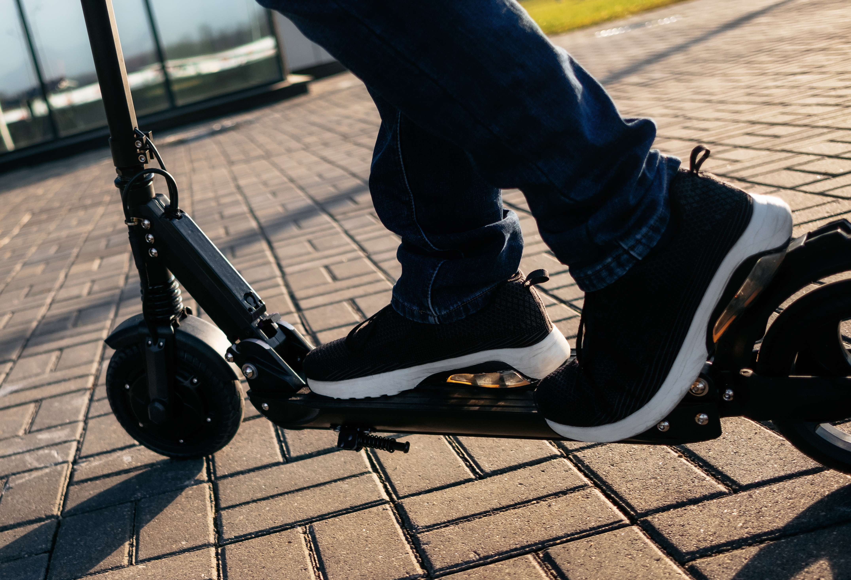
Most common accidents
Sports accidents
Poisoning (alcohol and intoxicants)
Traffic accidents
Drowning is also among most common serious accidents
Source: THL (National Institute for Health and Welfare), Hoitoilmoitusrekisteri (Care Register for Health Care)

Slide 9
Discussion:
How can sports injuries be prevented?
Notes:
The answers can be found in the video on the next slide.

Slide 10
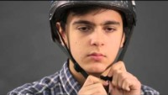
Notes:
Watch the video on how to prevent sports injuries. The video will start playing automatically. The video requires an internet connection: https://www.youtube.com/watch?v=Job0Cclc3us
English subtitles available on video

Slide 11
Discussion:
How can poisoning accidents be prevented?
Notes:
Discuss among the class. The answers can be found on the next slide.

Slide 12
Poisoning accidents
The most common causes of poisoning found in the home are detergents and cleaning products, medicines and alcohol.
Key ways to prevent poisoning injuries and deaths among young people (15 to 24 years):
Don’t use drugs or alcohol. There is a reason why there are age limits on alcohol and a total ban on drugs. Young people's bodies are more sensitive, and even a small amount of intoxicants can be dangerous.
Don’t abuse medication. Take medication only as prescribed by a doctor. Don’t take other people’s medication or share yours with others.
Dangerous substances in the home. Follow the instructions when using detergents, chemicals and solvents in the home.
Look after friends. If you suspect that a friend has been poisoned, call 112. Never leave intoxicated friends alone.
Make smart choices. You have the right to say no to drugs and take care of yourself - true friends respect that. At the same time, you set a smart example for others.
Notes:
Poisoning cases among children and young people
Efforts to prevent poisoning deaths among children and young people have paid off, and the number of poisoning deaths has fallen. Between 2019 and 2021, there were no accidental deaths due to poisoning among young people under 15.
The average number of poisoning deaths in ages 15 to 24 was around 60. More than three out of every four of these were young men.
The risk of needing hospital treatment for poisoning is highest among young children aged under 5 and adolescents.
Poisoning deaths among children have fallen significantly due to:
changes in laws, such as mandatory child safety caps for detergents and chemicals.
access to the Poison Information Center (Myrkytystietokeskus) hotline for emergencies
Poisoning incidents among young people:
Poisoning is the second most common cause of accidental death among 15 to 24 year olds every year.
Deaths are often the result of substance abuse and self-destructive behaviour.
Every year, hundreds people under the age of 25 are hospitalised due to accidental poisoning.
Keys to preventing poisoning incidents among young people:
investigating the background of substance use by young people
early identification of possible problems
providing advice and support.
It is especially important that young people in a vulnerable position have easy access to support and help.
Sources:
National Institute for Health and Welfare: https://thl.fi/aiheet/hyvinvoinnin-ja-terveyden-edistamisen-johtaminen/turvallisuuden-edistaminen/tapaturmien-ehkaisy/lasten-ja-nuorten-tapaturmat/myrkytykset
National Institute for Health and Welfare: https://thl.fi/aiheet/hyvinvoinnin-ja-terveyden-edistamisen-johtaminen/turvallisuuden-edistaminen/tapaturmien-ehkaisy/tapaturmat-suomessa/myrkytykset

Slide 13
If you suspect that someone has been poisoned, call the Poison Information Center at:
0800 147 111.
In an emergency, ALWAYS call
the emergency number 112.
Notes:
If you suspect someone has been poisoned:
If the person you are helping does not show clear symptoms of poisoning, but you suspect the possibility of poisoning or need advice and instructions, call the Poison Information Centre hotline at 0800 147 111 (open 24/7).
In an emergency, call 112 and follow the instructions of the authorities:
Do not make the person vomit unless told to do so by the authorities. If the ingested substance is corrosive, such as acids and alkalis, vomiting can cause further damage to the esophagus and mouth. Vomiting increases the risk of the poison entering the lungs, which can cause serious breathing problems. Vomiting does not necessarily remove the poison and may delay other, more effective treatments.
Call 112 again if the person’s condition clearly changes.
Monitor the person’s condition until professional help arrives.
To ensure the right first aid and emergency care in case of poisoning, it is important to find out:
What substance caused the poisoning?
How did the substance enter the body: swallowing, inhalation, or absorption or injection through the skin?
How much of the substance entered the body?
When did the poisoning happen?
Source: Terveyskirjasto.fi

Slide 14
Discussion:
How can traffic accidents be prevented?
Notes:
Discuss among the class. The answers can be found on the next slide.

Slide 15
Preventing traffic accidents
Wear the right protection: seat belt, helmet.
Follow traffic rules and speed limits
Be careful: when you drive, focus only on driving
Don’t drive drunk and don’t let others drive drunk.
Drive smart - even when with friends!
What kind of
driving behaviour
is risky?
Notes:
"Road accidents that involve young people often happen during outside work or school on weekends and nights, especially Saturdays during the summer months.
For young people, the risk of accident goes up after getting a moped licence, for example.
Young men are more likely than women to engage in risky behaviours, such as
driving at high speeds
ignoring traffic rules
drunk driving
not wearing a seat belt.”
Source: National Institute for Health and Welfare, https://thl.fi/fi/web/hyvinvoinnin-ja-terveyden-edistamisen-johtaminen/turvallisuuden-edistaminen/tapaturmien-ehkaisy/lasten-ja-nuorten-tapaturmat/liikenneonnettomuudet (in Finnish)

Slide 16

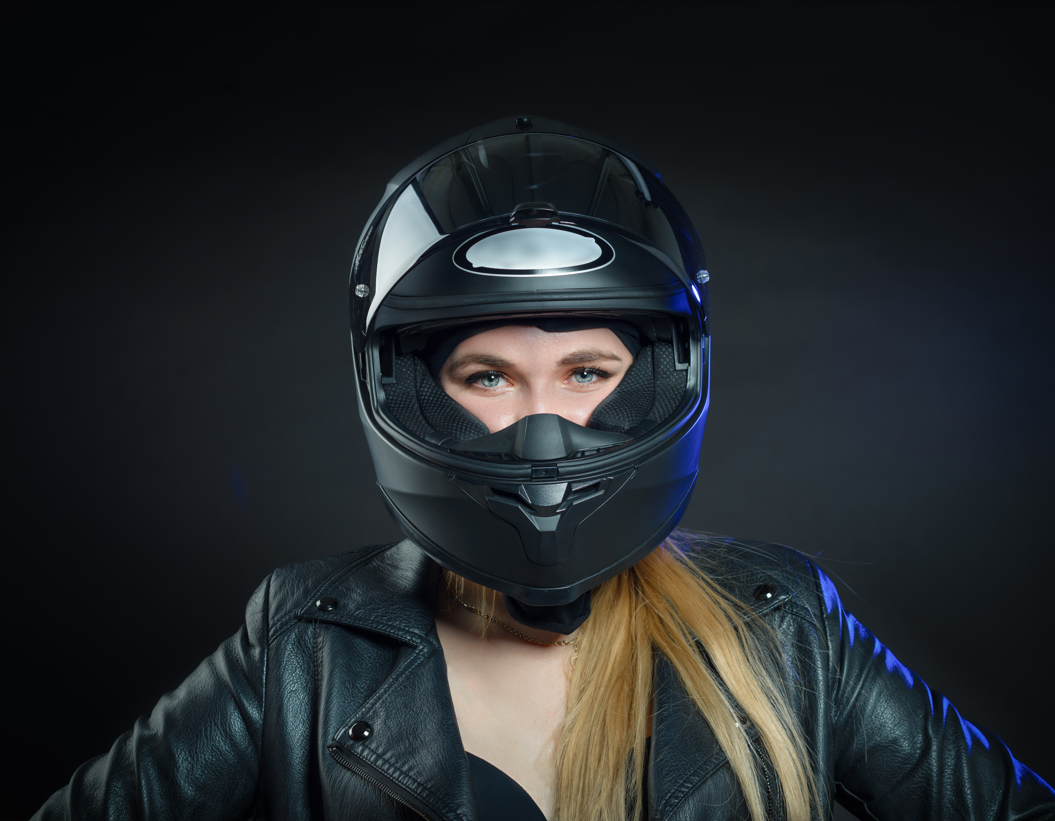
Traffic accidents involving young people are often caused by the overestimation of driving skills and risk-taking.
DON’T TAKE UNNECESSARY
RISKS!
About one in three injuries and one in five fatalities were young people (15-24 years old).
Young people are three times more likely to die in traffic compared to the rest of the population.
Notes:
Unnecessary risk-taking is often the underlying reason of traffic accidents involving young people. What is risk-seeking behaviour and how is it visible in traffic? Why and how do young drivers take risks?
Using a phone while riding a moped or e-scooter, not wearing a helmet, wearing unsuitable clothing, driving under the influence of alcohol or drugs, peer pressure or the feeling of pressure to drive in a way that is unsuitable or against traffic rules.
Source: https://www.liikenneturva.fi/en/road-safety/young-drivers/

Slide 17
Drowning cases in Finland
The number of drownings among under 18 year olds has decreased over the last twenty years, but drowning remains one of the most common causes of accidental death among children under school age.
The average from 2010 to 2020 was 5.3 drowned children every year.
The most common types of drowning events are:
swimming, splashing about or cooling off in the water
accidentally falling into the water
traveling in a boat or watercraft
falling through the ice.
In Finland, 100 to 150 people drown every year.
Source: Finnish Swimming Teaching and Lifesaving Federation
Notes:
"Over the past ten years, 147 people in Finland drown accidentally every year.”
"Drowning cases occur in all age groups, but children and the elderly are particularly at risk in Finland. More than 80% of people who drown are men.”
Source: https://suh.fi/viestinta/hukkumistilastot/tietoa-hukkumisista/ (in Finnish)

Slide 18
Drowning cases in Finland
Most cases of drowning could be prevented:
with the right safety mindset and preparedness,
by always wearing a life jacket when out on the water,
by staying sober while out on the water and
by taking care of your functional ability and swimming skills.
Boys make up the majority of drowning deaths among children and adolescents.
Source: Finnish Swimming Teaching and Lifesaving Federation
Notes:
"How to prevent drowning accidents:
- Wear a lifejacket and only go out on the water when sober. - If the boat capsizes and you're unsure you can swim to shore, climb on the boat or hang on to the side of the boat, shout for help or use a whistle. - Keep an eye on children playing near or in the water. Hazardous places include rivers, ditches, tubs, swimming pools and wells. - Don't rely too much on your swimming skills. - Diving into unfamiliar waters is life-threatening. - Only go on the ice when you are sure it will hold and follow the warnings about ice. - When on the ice, bring ice axes, a metal-ended stick, a whistle and a phone to call for help. - It’s advisable to wear a flotation suit when out on the ice or water. Source: https://www.terveyskirjasto.fi/spr00004 (in Finnish)
In natural bodies of water, it’s recommended to swim parallel to the shore. It’s also a good idea to learn how to float and to bring a friend when going swimming.

Slide 19
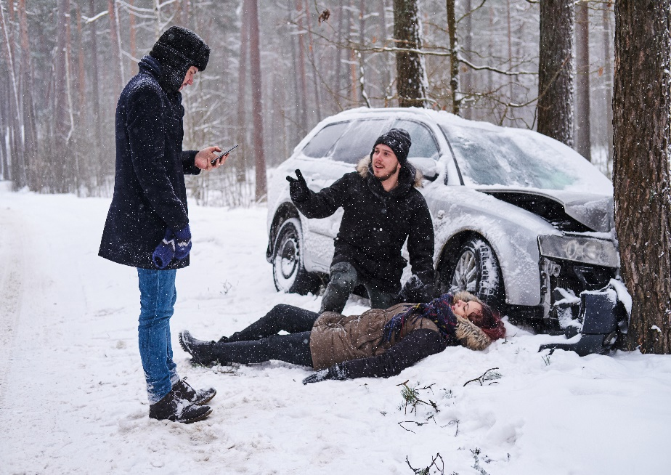
What to do in an emergency
Stop if you see an accident.
Take care of your own safety and prevent further injuries.
Find out what happened.
Call 112 and follow the instructions.
Notes:
Everyone has the duty to help others and the right to get help.
The most important thing is to stop and make sure that you are safe yourself.
After this, prevent further injuries and protect the person in need of help from traffic or other dangers.
Next, find out what happened and call 112 for help.
Follow the instructions of the emergency response centre and answer any questions. End the call only after given the permission to do so by the emergency responder.
Always help anyone in need of help to the best of your ability. Don’t leave the scene until professional help arrives and after given permission to do so.
Stay calm and look after your own safety and ability to function.
Talk to the injured person and listen to what they have to say.
Explain to the injured person that you will help them and call for help.
Stay with the injured person and tell them so.
Remember that as the helper, you may need also help after witnessing a shocking event.
Remember!
Depending on the situation, the order in which to do things may be different. Sometimes, it makes sense to call 112 immediately, while sometimes you should first take action to prevent further injuries. If there are many helpers present, one should call 112 right away while others prevent further injuries and , administer first aid.

Slide 20
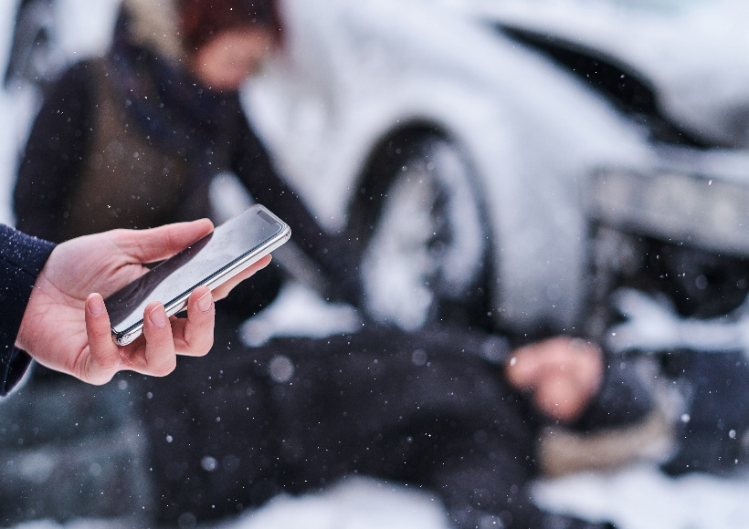
Helping is everyone’s duty
It is everyone’s legal duty to give aid in an emergency.
The most important thing is to stop and find out if help is needed.
If necessary, call 112 for advice and instructions on what to do.
Notes:
Helping those injured is everyone’s duty. The most important thing is to stop and help, even if you’re unsure what to do or don’t have first-aid skills. If you see a person lying on the street, the most important thing to do is ask if they need help. You can try to wake up the person by talking to them and shaking them gently. If the person does not wake up, call the emergency number 112. The emergency response centre gives further instructions on how to help.
Always call 112 when your or someone else’s life, health, property, or the environment is threatened or in imminent danger, or you have reason to believe so.
The emergency number can be called without a SIM card, credit balance and often even if the screen lock is active. You can also use voice commands to call: "Hey Siri, call 112!"

Slide 21
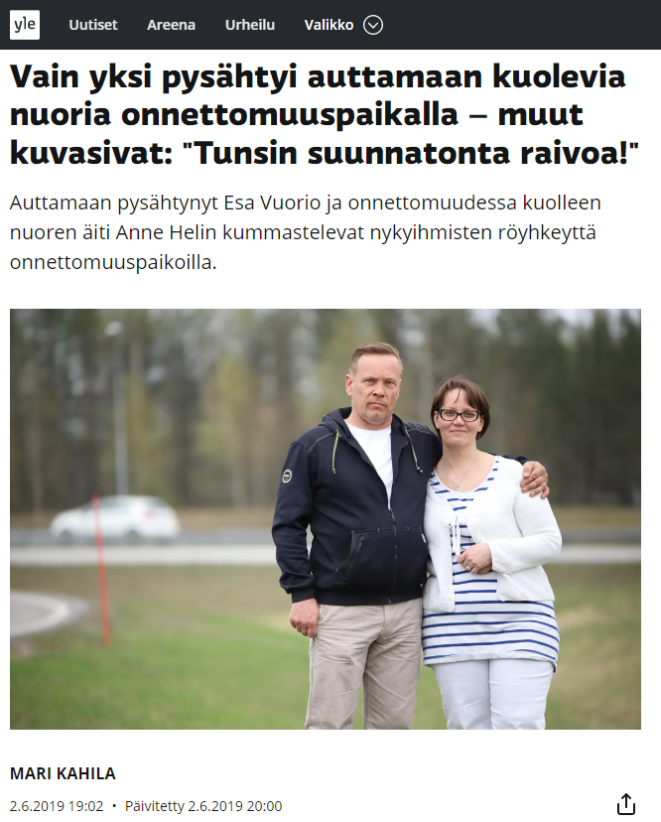
Why is it forbidden to take photos or video at the scene of an accident?
Notes:
Only one stopped to help dying young people at the scene of an accident - others took photos: “I felt immense rage” https://yle.fi/uutiset/3-11549560 (article in Finnish)
Source: YLE.
Answers on the next slide.

Slide 22
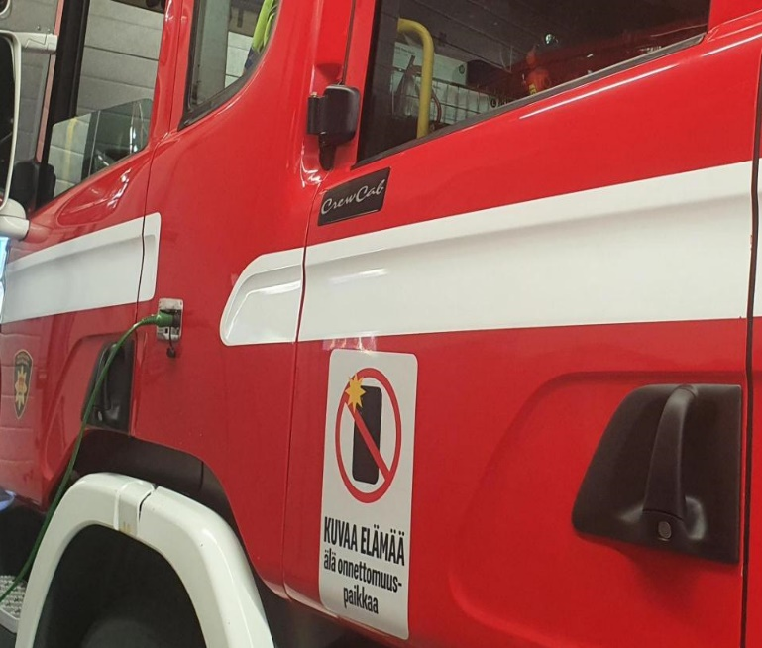
Don’t take photos or video, help!
In an emergency, it is everyone’s number one duty to ensure that those injured get the help they need.
Help others and give first aid - taking photos or video of the scene delays help and may cause more suffering to the injured or their families.
Notes:
Taking photos and video is legal in public places
Recently, there has been much discussion about a worrying phenomenon where people take photos of medical emergencies or accidents instead of helping. Taking photos or video can delay help from arriving and cause more damage and suffering for the person or their family. It is important to discuss this phenomenon and its causes with young people.

Slide 23

Notes:
Watch the video Kuvaa elämää – älä onnettomuutta.The video will start automatically. The video needs an internet connection.
https://www.youtube.com/watch?time_continue=1&v=vMceiGoRIXE&feature=emb_logo
In 2022, the Finnish Fire Officers' Association, Finnish National Rescue Association, Finnish Association of Contract Fire Brigades, Finnish Rescue Professionals SPAL and the Finnish Emergency Medical Services Association launched a media campaign developed in the project “Tieliikennepelastamisen kehittäminen Suomessa’ (Development of road rescue services in Finland). In addition to the media campaign, stickers were handed out reminding people to help instead of taking photos and video at the scene of an accident.

Slide 24
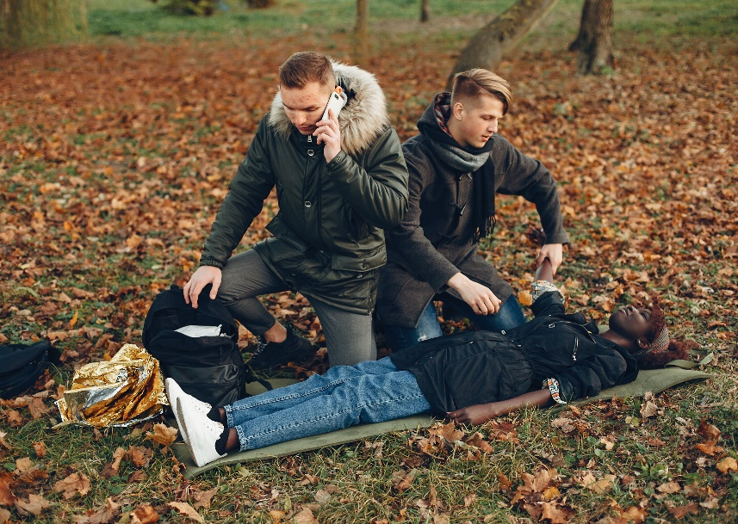
First aid can save a life
First aid for wounds
First aid for burns
Ensuring the breathing of an unconscious person (recovery position)
First aid in a cardiac arrest (resuscitation and using a defibrillator)
Rescuing a person from the water
Notes:
Emergency first aid can save a life
The main goal of first aid is to ensure the person’s breathing and blood circulation.
The steps to helping in case of injury or medical emergency are:
rescuing the person
emergency first aid
emergency care by first responders
transport and treatment

Slide 25
How are bleeding, dirty, deep or major wounds treated?
How are small wounds treated?
Notes:
Answers on the next slide.

Slide 26
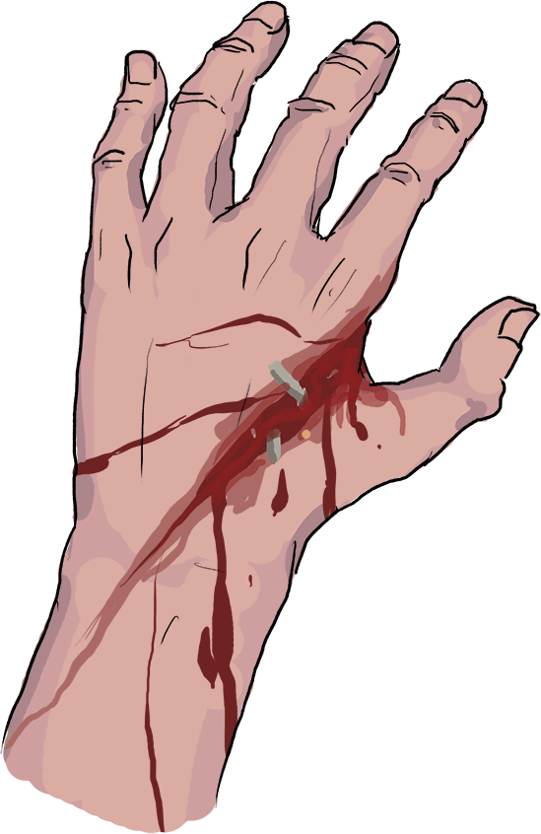
First aid for wounds
Stop any bleeding.
Clean the wound with cool running water.
Cover the wound with a plaster, bandage or similar.
Check that the injured person’s tetanus vaccine is up to date.
If the wound is bleeding, deep, dirty or large, medical attention is needed.
Notes:
If there is a foreign object attached to the tissue, such as a splinter or knife, don’t remove it.
Source: https://www.redcross.fi/first-aid/first-aid-instructions/wounds/

Slide 27
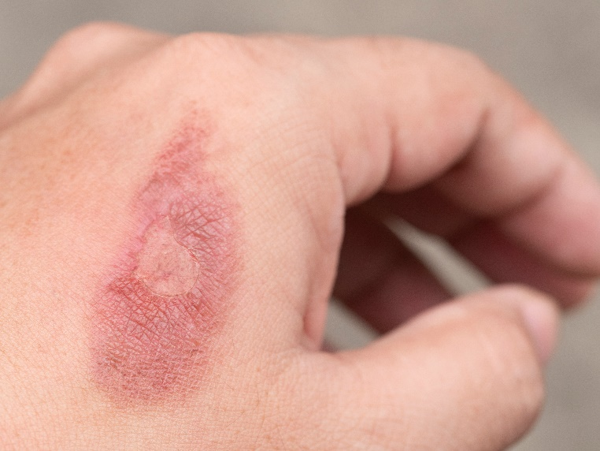
Classification of burns
First degree: pain and redness on the skin, no blisters.
Second degree: blistering on the skin.
Third degree: the skin has been destroyed.

Slide 28
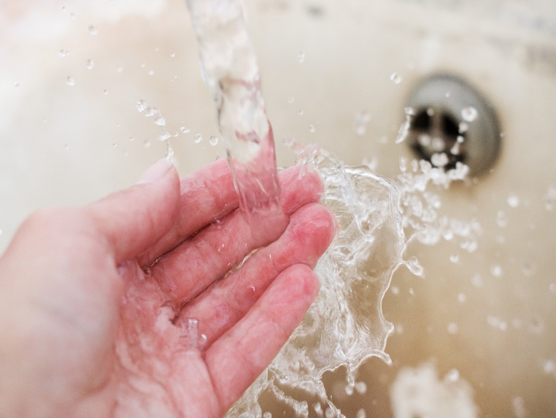
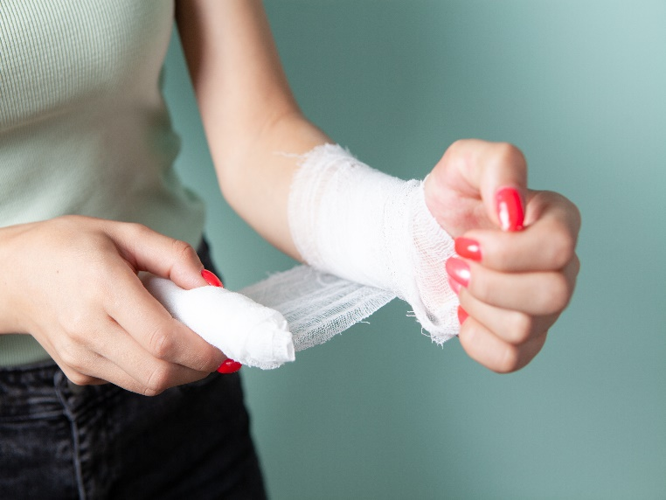
First aid for burns
First degree burns smaller than the palm of the hand can be treated at home.
Do as follows:
Cool the burnt part of body in cool water.
Keep under water for 15-20 minutes.
All other burns require professional medical care.
Do as follows:
Cover the burn with a clean and dry bandage.
Take the patient to a hospital.

Slide 29
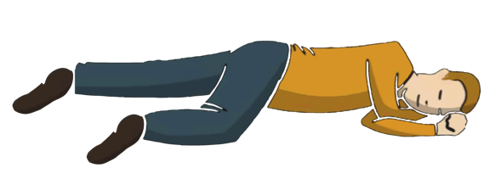
First aid for an unconscious person
Do as follows:
Try to wake up the person:
Call 112
Check that the person is breathing.
Open the airways by extending the head.
Turn the person to the recovery position on their side.
Observe the person’s breathing.
TASK FOR PAIRS:
Take turns practicing how to ensure the breathing of an unconscious person according to the instructions.
Notes:
Official instructions of the Finnish Red Cross on how to help an unconscious patient:
Check for response: First, find out whether the person is conscious and if they can wake up. Can you get them to wake up? Talk to the person and gently shake them. If the person does not wake up:
Call 112 if the person does not wake up. Put your phone on speaker mode to free your hands. Follow the emergency response centre’s instructions.
Check breathing: Place the person on their back and check if they are breathing normally.
Open the airways by tilting the head back and lifting the tip of the chin. Feel the flow of air with your cheek and check if the chest is moving.
Turn the person to a recovery position on their side as shown if they are breathing normally.
Monitor breathing: Make sure the airways are open and breathing is normal. Keep monitoring the person’s condition until professional help arrives.
Practice performing the recovery position. Sometimes, simply turning the person to a recovery position can save a life. The recovery position is the best way to make sure the airways stay open.
1) Position the person’s arm nearest to you at a right angle with the palm facing up and place the other arm over their chest. 2) Bend the person’s knee furthest from you.
3) Grab the person by their shoulder and the bent knee and turn them sideways towards you.
4) Place the hand on the chest under the cheek with the palm facing up.
5) Place the leg on top at a right angle.
6) Ensure breathing by tilting the head back.
See the Finnish Red Cross first aid instructions for more: https://www.redcross.fi/first-aid/first-aid-instructions/elvytys/cardio-pulmonary-resuscitation-cpr-and-basic-lifesaving-support-bls/

Slide 30
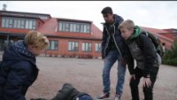
Notes:
Watch the video of a young person discovering someone who is unconscious. The video will start automatically. The video needs an internet connection.
https://www.youtube.com/watch?v=3jGeYgvDlcI
English subtitles available on video

Slide 31
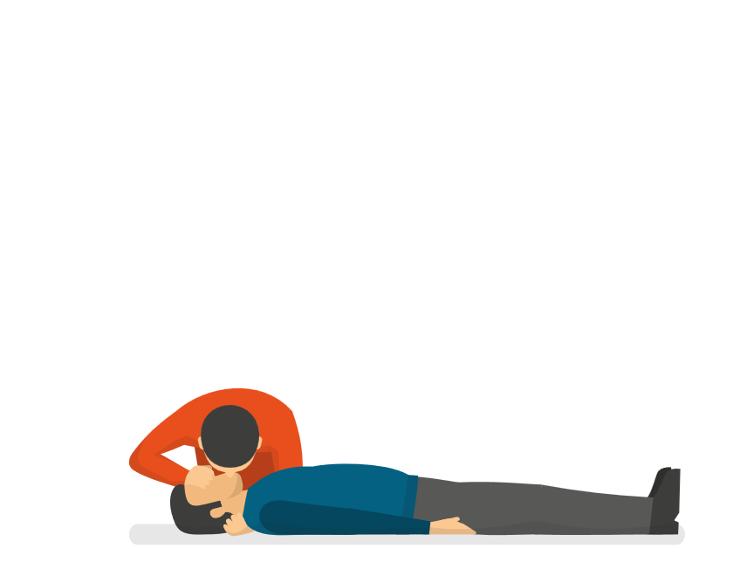
First aid in a cardiac arrest: CPR
Practice the position of the hands when giving CPR.
If the person is unconscious and not breathing, call 112. The emergency response centre will instruct you on how to give CPR.
Compress hard 30 times at the centre of the sternum. Rate: 2 presses per second. The sternum gives way.
Breathe twice into the lungs of the person if you can. First, open the airways: lift their chin and close their nose when breathing in air.
Continue these steps in turns.
Practice the CPR rhythm by clapping.
Notes:
If an unconscious person does not wake up, start CPR. If you have no experience with CPR, you will be given instructions when you call 112.
If you don't know how to give CPR, push down on the chest anyway. Chest compression is the most important thing for the person’s survival.
When giving CPR to adults:
First, open the airways.
Press down on the sternum 30 times with your arms straight. The sternum gives way about 4 to 5 cm on each press.
Continue with mouth-to-mouth resuscitation: open the airways and close the nostrils with your thumb and index finger. Press your lips tightly on the person’s mouth.
Blow air into the lungs 2 times while keeping an eye on the movement of the chest
Continue the chest compressions and mouth-to-mouth breaths at a rate of 30 compressions and 2 breaths until professional help arrives, the person resumes breathing or you don’t have the strength to continue. IMPORTANT! If there are others present, ask someone to quickly find a defibrillator
If you don’t know how to give CPR, perform the chest compressions anyway.Chest compressions are the most important thing for the patient’s survival. Starting CPR quickly makes the chance of recovery much more likely!
You can practice CPR skills at school by participating in the NouHätä campaign and in hobby groups and courses offered by organisations such as the Finnish Red Cross.
Task:
Go over the position of the hands when giving CPR: place the palms on top of each other and the heel of the hand on the chest at the point of compressions.
Remind the class that CPR can only be practiced with dolls, under no circumstances with another person.
When you have checked the position of the hands, find a rhythm of about 100 beats per minute. Test the rhythm by clapping and tapping your hands against a table.
More information:
CPR instructions by the Finnish Red Cross: https://www.redcross.fi/first-aid/first-aid-instructions/elvytys/cardio-pulmonary-resuscitation-cpr-and-basic-lifesaving-support-bls/

Slide 32
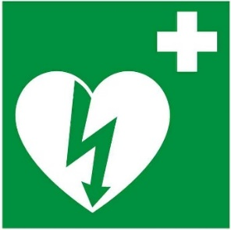
First aid in case of cardiac arrest - defibrillator
Do as follows:
Open the defibrillator case, turn on the device, listen, and follow the audio instructions.
Take the electrodes and attach them to the bare chest as instructed.
The device will tell you if the person needs a shock. Don’t touch the patient while the device is performing the check and administers the shock.
If a shock is needed, keep clear of the patient and press the button.
Continue giving CPR as instructed by the defibrillator and the emergency response centre The defibrillator is not a substitute for chest compressions and mouth-to-mouth breaths - these should be continued as instructed alongside the defibrillator.
Notes:
If you need to perform CPR, a defibrillator allows you to restore the heart to a normal rhythm and help save the person’s life.
Everyone can and is allowed to use a defibrillator in an emergency. The device gives step-by-step instructions on what to do. IMPORTANT!A defibrillator cannot harm the person as long as you follow the instructions.
Even if everyone is allowed to and can use a defibrillator, it’s a good idea to practice its use. Practice gives you the confidence use a defibrillator in an emergency. Schools should consider purchasing a training defibrillator. Some training defibrillators also provide feedback on CPR, so the teacher does not have to evaluate how the student is doing.
Defibrillators can be found in many public places, such as shopping centres, workplaces and sports facilities. Go to defi.fi to locate your nearest defibrillator. Defibrillators are marked with a green symbol.

Slide 33
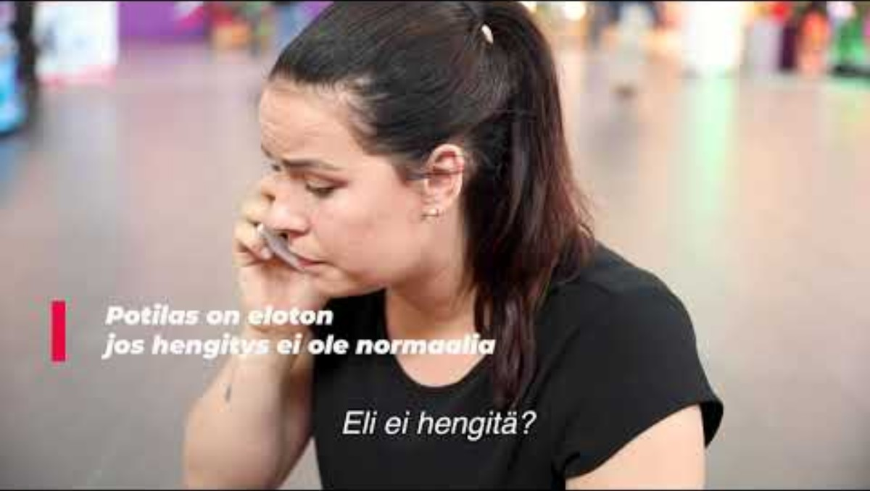
Notes:
Watch the video on this or the next slide on how to use a defibrillator. The video on the following slide is also available in Swedish (link in the slide).
This slide shows a video by the Rescue Department for Central Finland. On the video, a defibrillator is used in addition to CPR. The video will start automatically. The video needs an internet connection.
Link to video: https://www.youtube.com/watch?v=V-tVAXFGoOc

Slide 34
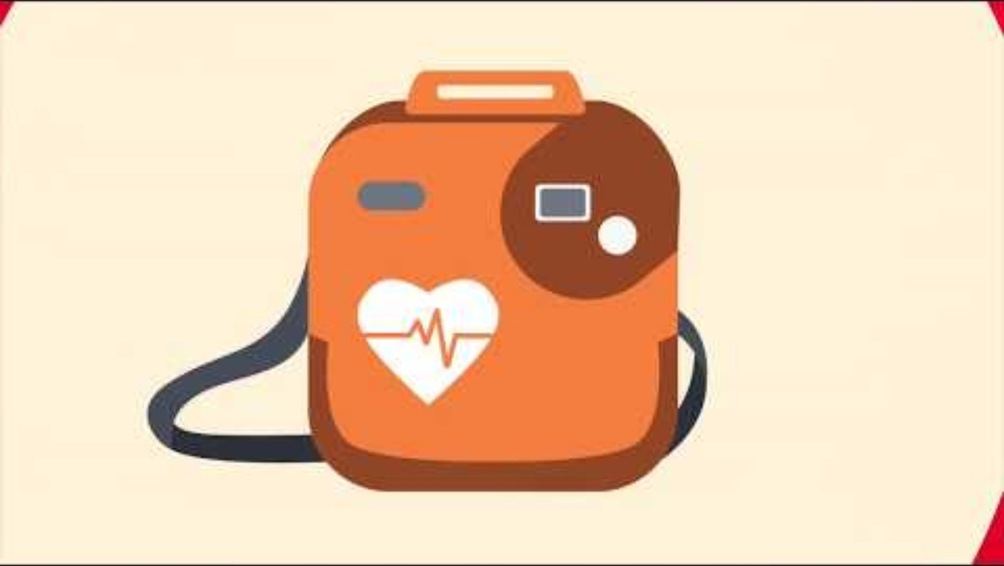
Notes:
Watch the video about defibrillators. The video will start automatically. The video needs an internet connection.
https://www.youtube.com/watch?v=7uHU6O06iGg
Sydäniskuri tutuksi video, subtitles in Swedish https://www.youtube.com/watch?v=hRh6xWODN4U

Slide 35
First aid in case of cardiac arrest - defibrillator
Locate your nearest defibrillator.
You can find the locations of defibrillators in the 112 Suomi app and at Defi.fi
Everyone can and is allowed to use a defibrillator in an emergency.
Notes:
If you need to perform CPR, a defibrillator allows you to restore the heart to a normal rhythm and help save the person’s life.
Everyone can and is allowed to use a defibrillator in an emergency. The device gives step-by-step instructions on what to do. IMPORTANT!It is impossible to harm the person with a defibrillator.
Even if everyone is allowed to and can use a defibrillator, it’s a good idea to practice its use. Practice gives you the confidence use a defibrillator in an emergency. Schools should consider purchasing a training defibrillator. Some training defibrillators also provide feedback on CPR, so the teacher does not have to evaluate how the student is doing.
Defibrillators can be found in many public places, such as shopping centres, workplaces and sports facilities. Go to defi.fi to locate your nearest defibrillator. Defibrillators are marked with a green symbol.

Slide 36




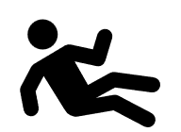
Rescuing a drowning person
H
R
112
K
!
A
= Keep calm
= Alert
Keep calm and reassure the person being rescued by telling them that help is on the way. It gives the person a sense of security and the strength to hang on for a while longer.
If possible, call for help before starting actual rescue measures. This helps ensure that additional help can arrive.
Source: Finnish Swimming Teaching and Lifesaving Federation
Notes:
Even if you consider yourself a good swmmer, remember the rule of thumb for rescuing yourself from the water: reach, throw, go, row.
If you notice that someone is submerged in water, look for a landmark that will help you pinpoint their location. If possible, throw a floating object, such as an empty canister, into the water to the person.
Call the emergency number 112.
Once the person is back on shore or a boat, begin giving first aid. Start CPR if the rescued person is unconscious and not breathing normally.
Always get the person to professional medical care even if they regain consciousness quickly, as water in the lungs can cause serious problems later. Source: https://www.terveyskirjasto.fi/spr00004 (in Finnish)

Slide 37



Rescuing a drowning person
A
R
R
A
= Rescue
= Aid
Approach the person to be rescued with care, but quickly. Keep the rescue aid between you and the person and hand it to the person if they are close to the shore. You can also throw it to them. Help the person to the shore, perform any needed first aid and take the person for further treatment if necessary.
Find an aid, something long to extend your reach and keep you safe, preferably something that floats. If the conditions are difficult, get others to help you or call 112.
Source: Finnish Swimming Teaching and Lifesaving Federation
Notes:
Special form of CPR: Drowning Recognising when a person is drowning is an essential part of first aid. A drowned person is mainly suffering from oxygen deprivation. For this reason, CPR for a drowning victim is always started with five mouth-to-mouth breaths. After this, continue chest compressions and breaths as instructed previously, 30 compressions and 2 breaths.
Source: https://www.redcross.fi/first-aid/first-aid-instructions/elvytys/cardio-pulmonary-resuscitation-cpr-and-basic-lifesaving-support-bls/

Slide 38
First aid for mental health concerns
When you are concerned about the mental health of another person:
Notice - if the person or your friend is withdrawn, sad or their behaviour has changed.
Ask - Ask how they are doing - even small questions can make a difference.
Listen - Don't play down their problems, give space for the person to talk
Get help together - tell an adult or contact the Sekasin chat or helpline: 09 2525 0111
Help for yourself:
Stop - acknowledge that you’re feeling weighed down.
Share - tell a trusted adult or a friend.
Get help - places to ask for help include the Sekasin chat, crisis helpline or an adult, nurse or counsellor at the school.
Look after yourself - get rest, exercise and do things you enjoy.
Notes:
Everyone has the right to mental health
Everyone experiences difficult emotions - that's part of life.
Help is always available - you’re not on your own!
Talk to a trusted adult or a friend - sharing makes the burden easier.
Look after your friends - simply asking how someone is doing can matter a lot.
Emotions and moods change, and feeling low is not permanent.

Slide 39
First aid for mental health concerns
Help for mental health issues is available at:
Sekasin chat (online)
Mieli ry crisis helpline: 09 2525 0111 (24/7)
Child and youth helpline 116 111 (free, open every day)
Trusted adult, such as a parent, teacher, coach
Talking to a friend and going to an adult together
In case of emergency, call ALWAYS
the emergency number 112.

Slide 40
REVISION
LESSON 3:
ACCIDENTS AND INCIDENTS
Notes:
Review the main content of the lesson.

Slide 41


Most common accidents:
Sports accidents
Poisonings (alcohol and drugs)
Traffic accidents
Drowning is also among most common serious accidents
1. What are the most common accidents?
The learning objective has been achieved:
1. You can identify risks of accident.
Notes:
Most common accidents:
Sports accidents
Poisonings (alcohol and drugs)
Traffic accidents
Drowning is also among most common serious accidents

Slide 42

Sports accidents:
Warm up
Learn the instructions and rules
Wear protective equipment
2.
How could the following accidents be prevented?
Poisoning accidents:
Keep medicines, detergents and other chemicals out of the reach of children
If possible, use products with a safety cap.
Store substances in their original packaging
Traffic accidents:
Practice your driving skills
Wear safety equipment
Follow traffic rules
As a driver, focus on driving. As a passenger, don’t distract the driver
Take breaks if necessary
Don’t drive while intoxicated
The learning objective has been achieved:
2. You know how to avoid accidents.
Notes:
Sports accidents:
Warm up
Learn the instructions and rules
Wear protective equipment
Poisoning accidents:
Keep medicines, detergents and other chemicals out of the reach of children
If possible, use products with a safety cap.
Store substances in their original packaging
Traffic accidents:
Practice your driving skills
Wear safety equipment
Follow traffic rules
Focus on driving and don’t distract the driver
Take breaks if necessary
Don’t drive while intoxicated
Avoid unnecessary risks!

Slide 43

Stop, calm down and calm others.
Prevent further accidents.
Help instead of taking photos or video.
Always take care of your own safety and ability to function.
If necessary, call 112.
3.
What do you do in the event of an accident?
Notes:
Stop and calm down.
Prevent further injuries and damage.
Help instead of taking photos or video.
Always take care of your own safety and ability to function.
Calm down the victims or those have been injured.
If necessary, call 112.

Slide 44
First aid for wounds:
Minor wounds: Stop the bleeding, clean, close, cover. Check vaccination status.
Large or dirty wounds always require medical attention.
3.
What do you do in the event of an accident?
First aid for burns:
Minor first degree burns: Cool in water.
All other burns: Cover with a dry and clean bandage and take the patient for treatment.

Slide 45
First aid for an unconscious person
Try to wake up the person by shaking them. If the person does not wake up, call 112.
Turn the person on their side and open their airways. Is the person breathing?
3.
What do you do in the event of an accident?
A) Unconscious but breathing:
Turn to a recovery position on their side.
Monitor breathing until help arrives.
B) Unconscious and not breathing:
Start CPR and ask someone to get a defibrillator.
30 compressions, 2 breaths (in case of drowning, start with mouth-to-mouth breaths).
Continue until help arrives.
The learning objective has been achieved:
3. You can describe what to do in an accident.

Slide 46
www.nouhata.fi/en

