Slide 1



www.nouhata.fi/en

Slide 2
LESSON 4:
DISRUPTIONS AND PREPAREDNESS
Notes:
NouHätä! lesson 4:
Incidents and how to prepare for them
The next slide lists the learning objectives of this lesson.

Slide 3
LESSON 4:
DISRUPTIONS AND PREPAREDNESS
After this lesson, you…
01
...can describe how to prepare for incidents.
02
...can describe what to do in different incidents.
Notes:
Go through the learning objectives of the lesson.
Next theme to study: 1. Different types of incidents

Slide 4

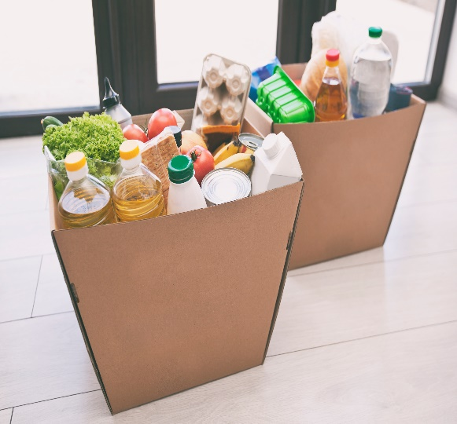
§
What is an incident? What is meant by home preparedness?
Incidents include, for example:
Prolonged power outages that result in public services to be disrupted or shut down entirely.
Water supply disruptions that cause water supply to be cut off or contaminated.
Preparedness means preparing in advance for power outages or problems with water supply, for example.
Notes:
What is an incident?
An incident means a hazard or event that endangers the functioning and safety of society at least temporarily. For example, a prolonged power outage can result in public services to be disrupted or shut down entirely.
In a power outage or blackout, electricity is cut off and unavailable.
In a water supply disruption, water may be cut off or contaminated, for example.
What is meant by preparedness mean?
Home preparedness means actions that you can take at home to prepare in advance for different incidents. The purpose of preparedness is to ensure that people can survive in the event of an incident.
72 hours:
72 hours is a household preparedness recommendation developed by the authorities and non-governmental organisations. Households should be prepared to get by on their own for at least three days in the event of an incident.
For example, a prolonged power outage can result in public services to be disrupted or shut down entirely.
https://72tuntia.fi/

Slide 5

Where can you find reliable information in the event of an incident?
Check out the emergency warnings (vaaratiedotteet) found on the YLE website, for example (in Finnish).
How does an emergency warning differ from news articles or social media posts?
Important! Never call 112 unless there is an emergency.
YLE channels on radio and TV
YLE website
112 Suomi mobile app
Possibly also certain commercial TV channels (such as MTV3, Nelonen and Sub).
Download the 112 Suomi app and explore its features together.
Notes:
The authorities may decide to have the emergency warning broadcasted on TV. Emergency warnings are broadcast on these TV channels: - YLE1, YLE2, YLE Teema and YLE Fem and commercial channels: - MTV3, Nelonen, and Sub. YLE also also publishes emergency warnings on its website, Teksti-TV and the YLE mobile app. Emergency warnings are published on the Emergency Response Centre Agency’s website 112.fi.
Source: https://intermin.fi/en/rescue-services/rescue-operations/emergency-warnings

Slide 6
How does a power outage affect daily life?
Will stop working:
Electrical equipment such as lights
Water outlets such as the shower
Card payment terminals in stores
Fuel pumps
Phones and other battery-powered devices will work until the battery dies
How would a power outage affect your life?
What would stop working?
Notes:
Answers to the discussion task:
Home electrical appliances, such as lights, electric stove, microwave and TV.
Showers, water taps and toilets will quickly stop working as water cannot rise to the apartment by itself. The water pump is powered by electricity and does not work during a power outage.
Payment terminals in stores do not work unless the store has a backup generator similar to hospitals, for example.
Battery-powered devices such as phones and laptops will continue working until the battery dies.

Slide 7
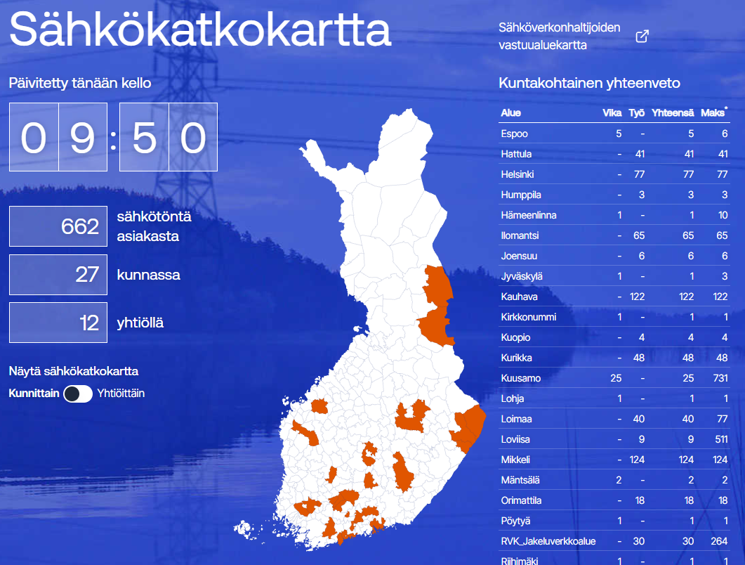
What can cause a power outage?
Possible reasons include:
Natural phenomena, such as storms
Technical malfunctions
Interruptions in power supply due to energy shortages
Fires and accidents
Have you experienced a power outage? Or have you heard or
read about a prolonged power outage?
Can you remember what caused the outage?
sahkokatkokartta.fi
Notes:
Answers to the discussion task:
Weather conditions such as heavy snow, flooding and storms can cause power outages. Repairing damage caused by nature is not always easy, and the power outage may last for a while. Sometimes, the power can be out for several days.
Power outages can also be caused by technical problems.
Energy distribution can be interrupted if electricity has to be rationed. In this case, power outages would likely be rolling blackouts. In a rolling blackout, electricity is cut off for two hours at a time, for example, to prevent refrigerators and freezers from thawing. Rationing ensures that there is enough energy for the critical functions of society.
Fires and accidents can also cause power outages.
Look at the map of power outages and discuss where outages can occur.
For example:
Windy areas → Trees felled by a storm damage power lines
Snowy areas → Heavy snow takes down trees on power lines

Slide 8
How does a water supply disruption affect daily life?
Water is cut off or contaminated, for example.
Don't work or can't be used:
Showers, faucets, toilet bowl...
Water is needed, among other things, for:
Drinking (including pets)
Cooking
Flushing the toilet
Washing hands and other hygiene
How would
a disruption in water supply affect your daily life?
What things would stop working?
What is water needed for?
Notes:
Answers to the discussion task:
The average person needs about two litres of clean drinking water every day.
Water is also needed for cooking and personal hygiene. The total amount of water needed by a person a day is enough to fill about 1 or 2 buckets.
The toilet can only be flushed once.

Slide 9
What causes water supply disruptions?
Possible reasons include:
Power outages
Water contamination
Roadworks
Repairs to the water supply network
Have you heard
or read about a water supply disruption?
Can you remember what caused it?
Notes:
Answers to the discussion task:
Water supply disruptions can be caused by a power outage or a contamination, for example
For example, roadworks next to pipelines may require cutting off water supply.
Water outages can also be local and affect only a single housing company due to plumbing work, for example.

Slide 10
Could you survive if the water went out?
IF THE WATER WENT OUT TONIGHT:
Is there suitable food in your home? How would you get water from a pickup point?
How would you go to the toilet?

Slide 11
You can prepare for incidents and disruptions
At home, it’s a good idea to have:
Food that is easy to prepare and suitable for the whole family
Pet food
Bottled water
Water containers (clean, with lids)
Garbage bags
Wet wipes
Toilet paper
Cash
Prescription medication and painkillers
Flashlights or headlamps
Batteries
Battery-powered radio
What should have at home in case the power or water goes out?
Why are these
items on the list?
Notes:
Go over the list and discuss why each item is on the list.
Answers on the next video.
Iodine pills
Take an iodine pill only when instructed by the authorities to ensure the dose is timed correctly. Follow the dosage instructions on the package.
Iodine pills can reduce the build-up of radioactive iodine in the thyroid gland.
Iodine pills are sold at pharmacies.

Slide 12
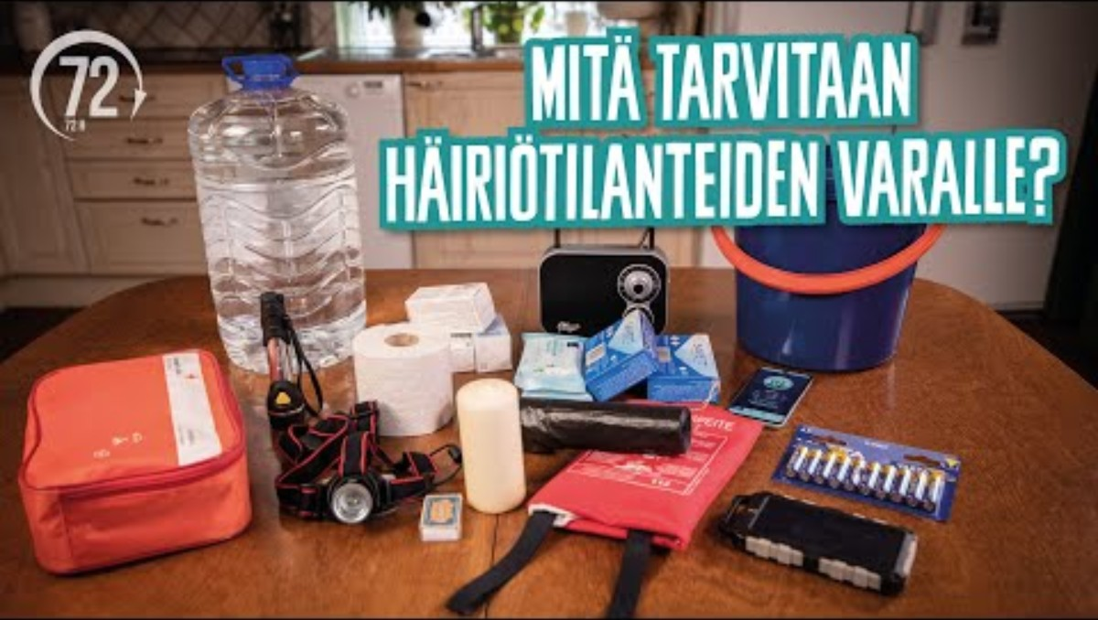
Source: 72tuntia.fi
Notes:
Check the answers to the list of supplies from the video. The video will start automatically. The video needs an internet connection.
https://www.youtube.com/watch?v=nuUM5pkofFg&t=243s

Slide 13
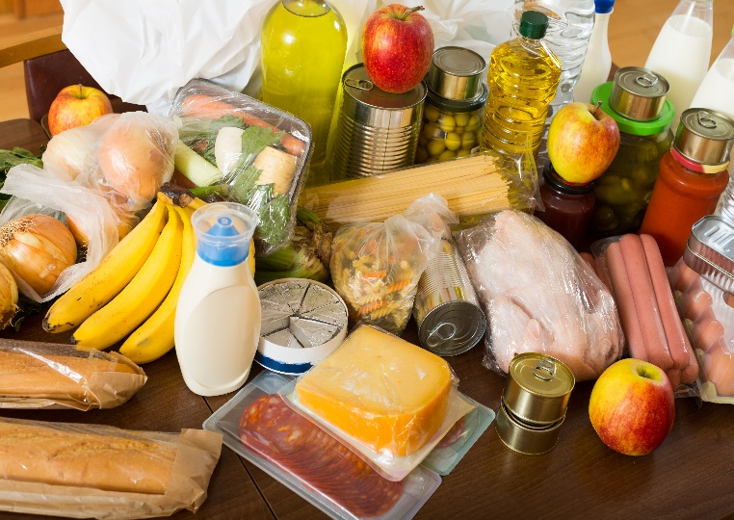
Food during a power outage
During the cold months, store perishable foods outdoors and well protected.
Avoid opening the freezer and refrigerator door unnecessarily.
Protect the undersides of fridges and freezers from meltwater.

Slide 14
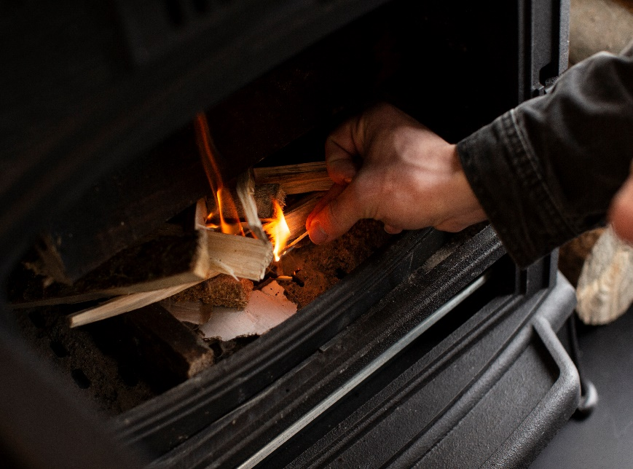
Heating during a power outage
If a power outage happens in the winter, your home will get cold very quickly.
Close and keep the front door and connecting doors closed. Seal all gaps.
Fireplaces are good backup sources of heat.
Have enough warm clothes and blankets on hand.
Eat well and get enough rest.

Slide 15
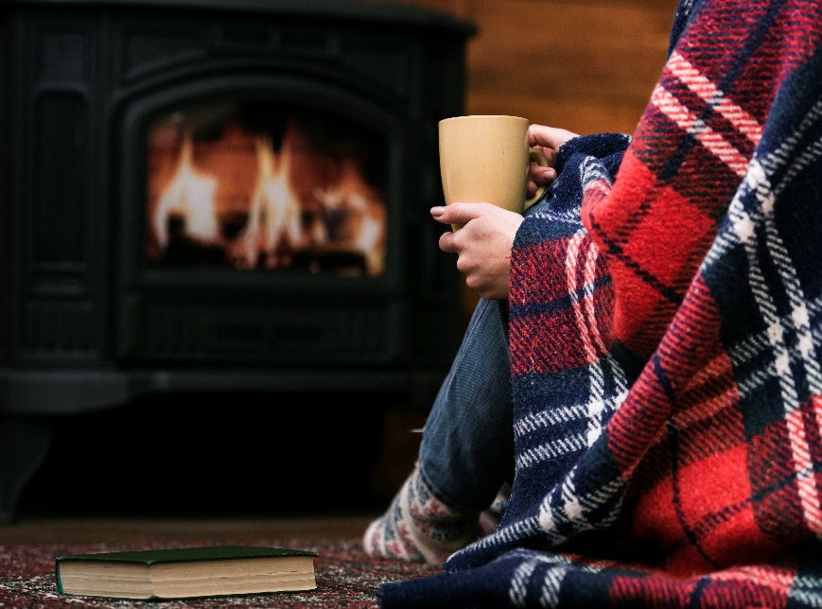
Heating during a power outage
If the temperature inside drops to below +15 degrees, try to keep one area of the home warm.
Wear warm, breathable clothes. Place more carpets on the floor.
Close the doors to the furthest away rooms and the hall and seal them with rugs, towels or tape to prevent draft.
Cover the windows with thick curtains or blankets.

Slide 16
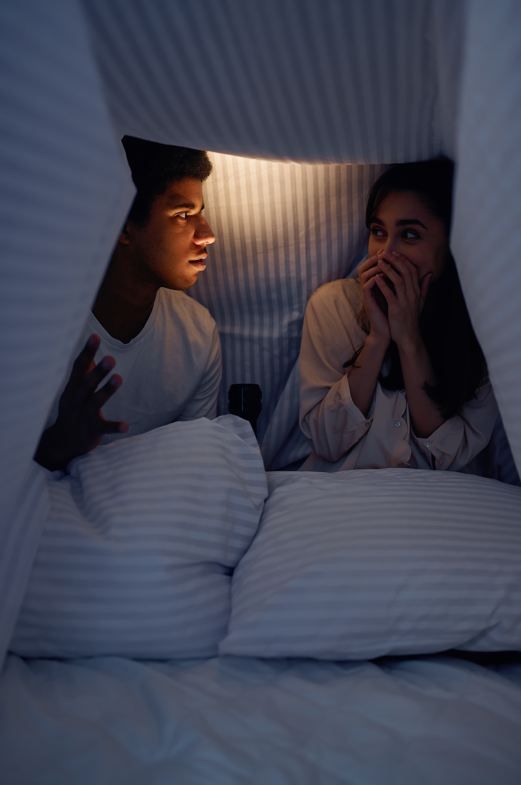
Heating during a power outage
If you have to spend the night in a cold home
Move the beds to the warmest area in the home.
Put all duvets, blankets and sleeping bags to good use.
Build a hut under a table, for example.
Sleep side by side under the same blankets.

Slide 17
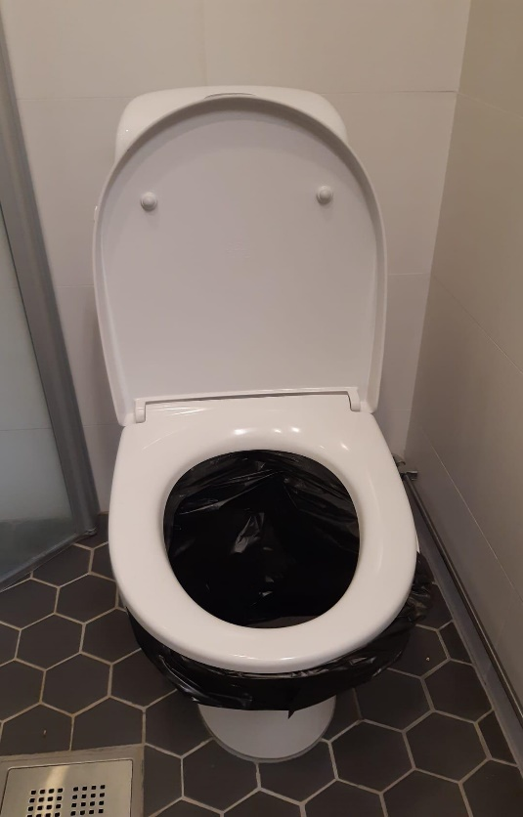
If the water is out
Fetch water from a pickup point.
If necessary, help carry water to neighbours or relatives.
The toilet can only be flushed once. A garbage bag can be placed inside the toilet. The bag is then disposed as mixed waste.

Slide 18

Could you survive a water outage?
Notes:
Answers to the discussion task:
Water outages can be caused by a number of reasons, such as a power failure or contamination of the water supply.
For example, roadworks next to pipelines may require cutting off water supply.
Water outages can also be local and affect only a single housing company due to plumbing work, for example.

Slide 19
If the water is contaminated
Put a note over all taps warning about contaminated water.
When clean water is again available, be sure to clean all appliances and containers that may contain contaminated water, such as a coffee machine.
How will you remember that water cannot be used even if the taps are working?
How do you make sure others also know and remember?
Follow the water utility provider's instructions on the use of water and boil-water advisory.
Notes:
If the water is contaminated
Prevent the use of contaminated water, for example by taping a warning note over the tap.
When clean water is again available, be sure to clean all appliances and containers that may contain contaminated water, such as a coffee machine.
Follow the water utility provider's instructions on the use of water and boil-water advisory.
Do not use water during shock chlorination of water pipes.

Slide 20

When and why should you shelter indoors?
Toxic smoke when there is a fire in the neighbourhood.
Traffic accident involving dangerous substances in the area.
Risk of radiation, such as a nuclear power plant accident.
The functioning of the public warning signal is tested on the first non-holiday Monday of the month at noon.
Public warning signal
When you hear the public warning signal, take shelter indoors.
Test sound
Notes:
Listen to the public warning signal and the test signal (click on the speaker icons) and discuss: what does the signal sound like? How does it differ from other warning signals?
The public warning signal is a one-minute rising and falling sound or a warning given by an announcement. The public warning signal warns people outdoors of a threatening imminent danger, such as a traffic accident of dangerous goods, or a radiation danger.
The all-clear signal is a one-minute uninterrupted sound. It announces that the threat or danger has passed.
The test signal is a steady sound lasting 7 seconds. The emergency warning system is tested on the first non-holiday Monday of the month at noon. The test may also include a voice announcement ”hälyttimien kokeilu, prov alarm, testing sirens”. Tests of the public warning signal do not require any action from residents and bystanders. The purpose of the test is to help detect any malfunctions in outdoor alarm systems. Rescue departments and the Emergency Response Centre Agency are responsible for testing emergency warning systems.
Smoke fumes from a fire is always harmful to humans, and breathing fumes may be dangerous or life-threatening. Smoke is easy to detect. • If you can detect the danger yourself, act immediately: shelter indoors and turn off the ventilation. • Shelter indoors at the latest when the authorities announce to do so with a public warning signal or emergency warning. • Some toxic gases can be detected by smell, for example, while others are unnoticeable. Certain dangerous substances are odourless and colourless.

Slide 21

What to do when sheltering indoors
The home should be sealed off from the outside as much as possible.
Close doors and windows.
Seal any gaps.
Turn off ventilation.
Follow the instructions you are given.
Civil defence shelters are readied and used only when instructed by the authorities.
Do you know
if your home has mechanical ventilation?
Can you turn it off yourself?
Do you know how to turn off the ventilation in your home if necessary?
Notes:
When sheltering indoors is necessary, the space should be made as sealed off as possible.
Shut all doors, windows and airways and seal all gaps with plastic wrap or duct tape, for example. This reduces the amount of smoke, gas or radioactive particles that can penetrate inside.
Everyone in the family or at a workplace should know how to shut down mechanical ventilation. However, not all buildings have mechanical ventilation and in some buildings, only the property maintenance company can shut down ventilation.
Iodine pills
Take an iodine pill only when instructed by the authorities to ensure the dose is timed correctly. Follow the dosage instructions on the package.
The accumulation of radioactive iodine in the thyroid gland can be reduced with iodine pills.
Iodine pills are sold at pharmacies.
Civil defence shelters
In exceptional circumstances, civil defence shelters may need to be used. Civil defence shelters are taken into use by decision of the authorities, in which case they will be ready for use in 72 hours. In other words, civil defence shelters are not in working order under normal circumstances and may not be used!
Civil defence shelters may only be used when instructed. Seeking out a civil defence shelter after hearing a public warning signal can be life-threatening as invisible toxic gases from gas leaks can settle in the basements of buildings, where civil defence shelters are often located.
The international sign a for civil defence shelter is a blue triangle over an orange background.
Most civil defence shelters are located in residential and public buildings. They are traditionally built in the basement.

Slide 22
REVISION:
LESSON 4:
DISRUPTIONS
AND PREPAREDNESS
Notes:
Review the main topics covered in the lesson.

Slide 23

YLE channels on radio and TV
YLE website
112 Suomi mobile app
Possibly also certain commercial TV channels (such as MTV3, Nelonen and Sub).
Important! Never call 112 unless there is an emergency.
Where can you find reliable information in the event of an incident?

Slide 24


Be prepared:
Food and water + container for water
Essential medication
Cash
Battery-powered radio, flashlight and batteries and other accessories
Wet wipes, toilet paper and garbage bags
Pet food
How can you prepare for incidents?
The learning objective has been achieved:
1. You can describe how to prepare for incidents.
Notes:
Water container
Medicines
Garbage bags
Battery-powered radio, flashlight and batteries
Sleeping bags and duvets
Backup power supply for charging your phone, for example
Camping stove and matches
Cash
Essential medication
Iodine tablets
Hygiene products
First aid supplies
Hand-held extinguisher or fire blanket

Slide 25
Call 112 in emergencies only
Follow the instructions of the authorities
Prevent food from spoiling
Keep your home and sleeping area warm
If the water is contaminated: put a warning on the tap
What to do in case of an incident?

Slide 26

When you hear the public warning signal
Chemical accident, radiation hazard or other disaster in the area.
When do you need to shelter indoors?

Slide 27

Make your home airtight:
Turn off ventilation.
Close doors and windows.
Seal any gaps.
Follow the instructions you are given.
Do not move to a civil defence shelter unless instructed to do so by the authorities.
Do not take iodine tablets unless instructed to do so by the authorities.
What should you do when sheltering indoors?
The learning objective has been achieved:
2. You can describe what to do in different incidents.
Notes:
Civil defence shelters are readied and used only when instructed by the authorities.
Iodine tablets should be taken only if instructed by the authorities.
Call 112 only in case of emergency.

Slide 28
www.nouhata.fi/en

