Slide 1
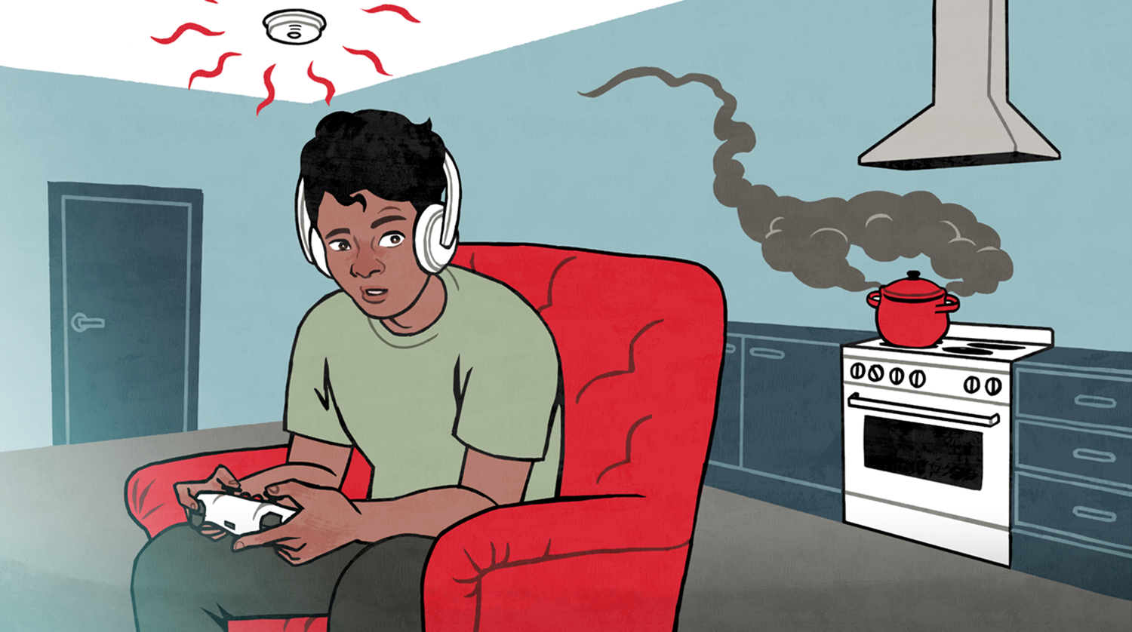
1.
You can name the most common causes of fires.
3.
You know what measures to take to improve the fire safety of your home.
2.
You can identify fire hazards.
LESSON 1:
PREVENTING FIRES
Notes:
Go over the theme of the class
Go over the learning objectives that you should know after the class.
Next topic to study: 1. Most common causes of fires.

Slide 2
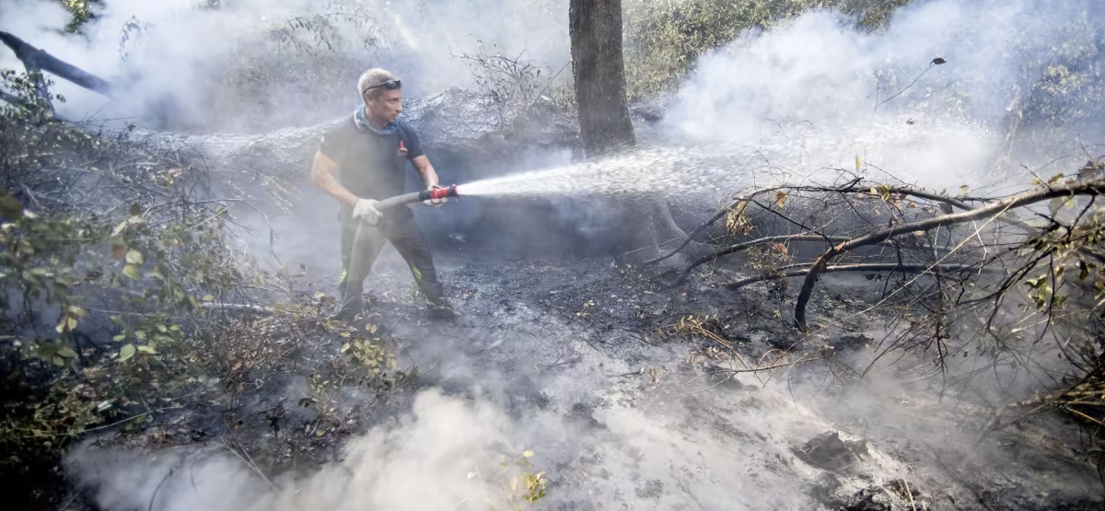
How could the accident have been avoided?
PUBLISHED 19 Sep 2020 at 17:09 https://yle.fi/uutiset/3-10745220
Source: yle.fi
Notes:
Listen to the news about a fire started by young people (click on the audio icon, only in Finnish) or read the news from the link or aloud.
“In Italy, two university students have been fined €13.5 million for a wildfire that broke out in the Como region last December, according to the British public broadcaster BBC and the Italian newspaper La Stampa, among other sources.
Late last December, the 22-year-old men were having a barbecue at one of the men’s grandparents' mountain cabin when the fire started.
The fire raged for several days, destroying about a thousand hectares of forest on Monte Berlinghera. According to the authorities, about one hundred hectares suffered irreparable damage.
According to an investigations, the fire started from charcoal at the cabin and was spread by drought in the area. The boys and the couple who owned the cabin were jointly and severally sentenced to pay the fines.
"We are being used as scapegoats"
One of the convicted students feels that they have been used as scapegoats for the fire. According to the defence, the fire originated from several sources.
He also tells La Stampa that the boys immediately called the fire brigade and tried to suppress the flames themselves.
One of the boys' lawyer also asks what is the point of imposing such a large fine knowing that the students will never be able to pay it.
The prosecutor in the case defends the fine to the newspaper Il Giorno Como (you will be transferred to another website) by saying that it is a signal to urge people to better protect the environment.
According to Italian media, the students may be faced with further claims for damages if they are sued by those who suffered property damage in the area affected by the fire.”

Slide 3
Each year, almost 12 000 fires break out in Finland.
1/3
3,000
Almost 3,000 fires break out in homes each year.
Almost one third of fires are caused by people’s negligence or are started deliberately.
8
Every day, there is a fire in eight homes.
49
In 2019, 49 people died in fires.
Notes:
Much of fires occur in homes.
In Finland, about fifty people die each year in household fires. This is higher than the average in Western Europe.
Many fires could have been avoided by small changes in habits: by being careful and observant and by following instructions and regulations.

Slide 4
Most common causes of fires
How can you avoid fires caused by cooking?
Unattended cooking
Careless use of open fire
Careless heating of a sauna
Electrical appliances
Using a device contrary to the user manual
Using a faulty device
Notes:
• Most common: Fires relating to food preparation break out approximately three times a day, or roughly one thousand per year.
• Second most common: Open fires. A fire caused by candles, tobacco, or other open fire breaks out in approximately 650 homes each year. Open fires include disposable barbecues and camp fires.
• There are approximately 400 sauna fires in Finland each year.

Slide 5
Intoxicants and smoking are a dangerous combination
The majority of people who die in fires were under the influence of alcohol or other intoxicants when the accident occurred.
A person under the influence of alcohol or intoxicants, and smoking, may easily fall asleep whereby a cigarette falling from the hand easily ignites home textiles.
This represents the most common cause of death in fires.
Notes:
Almost 75% of men and 65% of women who die in fires were under the influence of alcohol or other intoxicants at the time of the accident.
Heavy use of alcohol or other intoxicants in combination with smoking are among the biggest causes of fatal fires.
Careless smoking is still one of the most common causes of fires.

Slide 6
1.
You can name the most common causes of fires.
3.
You know what measures to take to improve the fire safety of your home.
2.
You can identify fire hazards.
LESSON 1:
PREVENTING FIRES
Notes:
Revision: Most common causes of fires.
Unattended cooking
Careless use of open fire
Careless heating of a sauna
Electrical appliances
Using a device contrary to the user manual
Using a faulty device
Next: Identifying fire hazards.

Slide 7
Can you identify
the fire hazard
in the image?

Slide 8
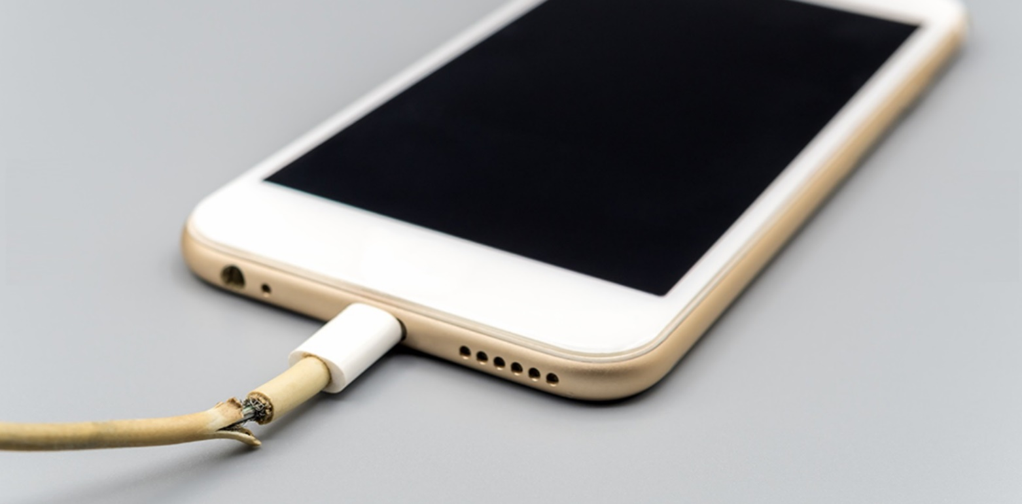
Notes:
Answer: Faulty electrical equipment

Slide 9
Notes:
Answer: Alcohol use and smoking.
Around 70% of victims of fires were under the influence of alcohol or other intoxicants at the time of the fire.

Slide 10
Notes:
Answer: Untidiness Maintaining good order and tidiness and storing flammable items correctly help prevent fires.

Slide 11
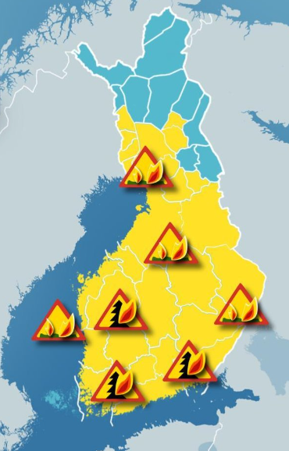
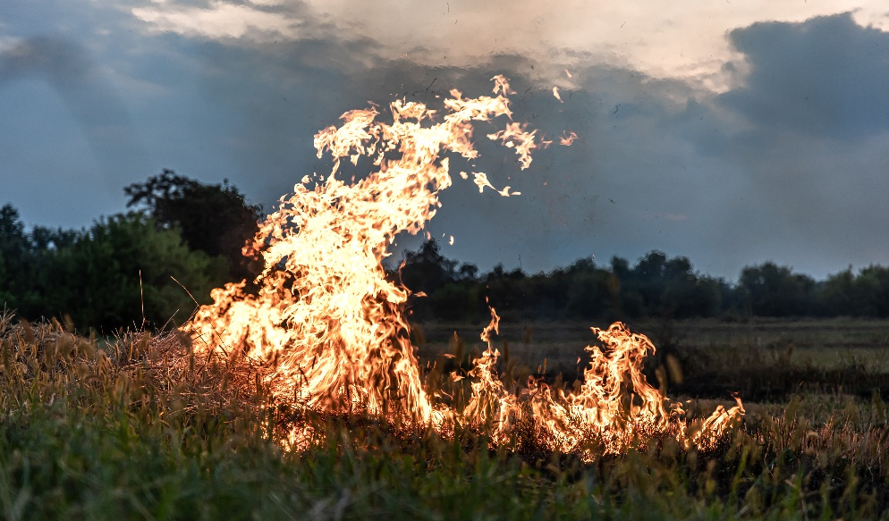
Source: YLE
Notes:
Answer: Heat and dryness
A campfire or other open fire may not be lighted if risk of forest fire, grass fire or other fire is apparent. Such a situation may arise from dry or windy conditions, for example.
A forest or grass fire warning may be issued for the area. During the warning, it is prohibited to light campfires or other open fires.
Forest fire warning warns when terrain is dry
The Finnish Meteorological Institute issues a forest fire warning when conditions in the forest are dry. Lighting open fires is not permitted while a warning is issued.
www.fmi.fi for information about warnings.

Slide 12
With small acts
and changes in your habits, you can effectively
prevent fires and dangerous situations.

Slide 13
What is required by law?
Everyone:
must be careful to avoid the risk of a fire.
has a duty to intervene in accordance with one’s ability in a dangerous situation and prevent an accident from happening or spreading.
Liability for damages:
Careless handling of fire may lead to extensive damage and liability for damages.
Anyone who has deliberately lighted a fire always has to compensate for the resulting damage. This also applies to under 15 year olds.
Notes:
Rescue Act
Section 2 of the Rescue Act refers to the general obligations which insofar as lives of the young are concerned in particular relate to the duty to be careful and care when handling fire.
It is important to understand that prevention of danger situations and accidents is everyone’s obligation.
Even though the legal requirement is to be careful and intervene in danger situations, it is important to understand that taking care of one’s own and everyone else’s safety is in the interest of everybody.
Link to the Rescue Act: http://www.finlex.fi/fi/laki/ajantasa/2011/20110379#L2.

Slide 14
1.
You can name the most common causes of fires.
2.
You can identify fire hazards.
3.
You know what measures to take to improve the fire safety of your home.
LESSON 1:
PREVENTING FIRES
Notes:
Revision: Fire hazards:
Alcohol and drugs + smoking
Untidiness
Heat and dryness
Next: Measures to improve fire safety at home.

Slide 15
Your smoke alarm must be functional
The smoke alarm detects fires quickly and warns those in the apartment or building.
By law, homes, summer houses, boats and other places where people sleep must have a smoke alarm.
Test the smoke alarm monthly. Replace the batteries at least once a year.
40% of deaths caused by fire happen in homes without a smoke alarm.
Notes:
A smoke alarm detects smoke fast - also when occupants are asleep - and sounds a loud warning signal. This gives you time to rescue yourself.
A smoke alarm is an accessory prescribed by law in each home and vacation home. The resident of the flat is responsible for acquiring and maintaining a battery-operated smoke alarm. The law and insurance are always on your side, if you see to your own obligation.
A smoke alarm needs maintenance.
Test: Test once a month. A good rule of thumb is to test the alarm on the first day or each month. The alarm is tested by keeping the test button pressed down for as long as you can hear a beep. The smoke alarm indicates that its battery is becoming exhausted by giving a faint warning signal at regular intervals.
Replace batteries: Replace the batteries once a year.
Replace the smoke alarm: A useful service life of a smoke alarm is 5 to 10 years from its manufacturing date. A smoke alarm must display information on its manufacturing date and the user manual must state when it is worthwhile to replace the smoke alarm.

Slide 16
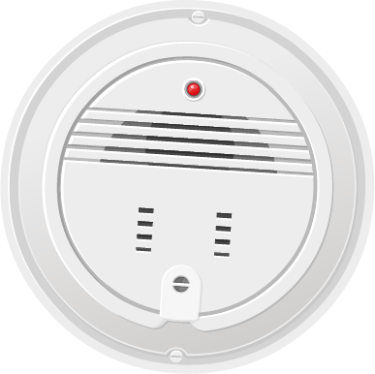
Come up with a rule of thumb to help you remember to your smoke alarm
every month.

Slide 17
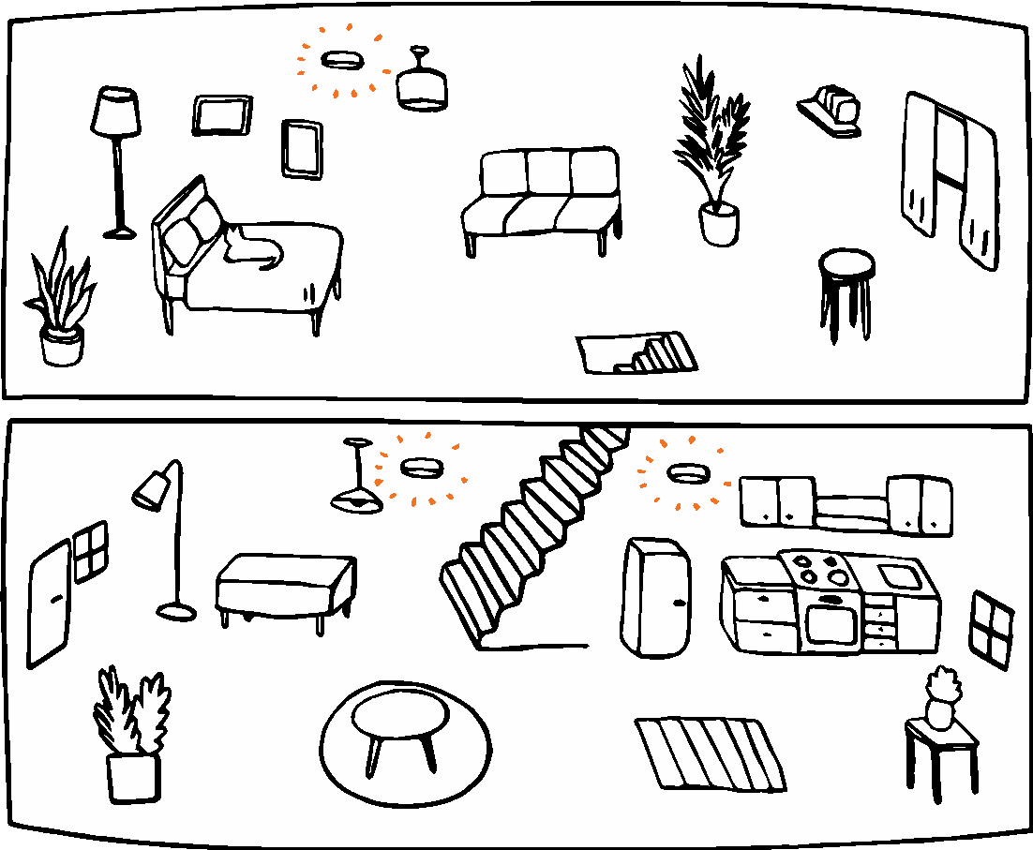
There must be enough smoke alarms
The house has
130 square meters,
of which 60 are upstairs
and 70 downstairs. How many smoke alarms does the house need?
Minimum requirement: There must be at least one smoke alarm for every 60 m² of each floor.
Recommendation: Smoke alarm for all rooms where people sleep and in the hall after the front door.
The upper floor has 60 square meters, so one smoke alarm is mounted to the ceiling.
The ground floor has a space of 70 square meters, so two smoke alarms are mounted to the ceiling.
Notes:
The picture is simplified but illustrates what the decree on smoke alarms means.
+ You can ask the class to think how many smoke alarms their homes must have according to the decree, and whether they have a sufficient number of alarms.

Slide 18
More and more fires
are caused by charging electronic devices.
Notes:
Some electrical appliances are battery-powered and work without a cord. However, the battery needs to be charged from time to time.
Lithium i.e. Li-ion batteries may be damaged by knocks and bumps, leading to an increased risk of a short circuit.
Lithium batteries, or Li-ion batteries, are used in phones, toys, computers, electric scooters and electric bikes, for example.

Slide 19
What is this about? Are you
already familiar with the phenomenon?
A Samsung Galaxy Note 7 phone unveiled last week at a trade expo in Berlin. Image: Jannis Mattar / EPA
PUBLISHED 10 Sep 2016 at 01:16, Updated 10 Sep 2016 at 14:06 https://yle.fi/uutiset/3-9157980
Source: yle.fi
Notes:
Listen to the news about battery fires (click on the audio icon, only in Finnish) or read the news from the link or aloud.
"US consumer authorities have called for the Samsung Galaxy Note 7 smartphone to be discontinued altogether. Samsung has also advised people to stop using the phone. The company has suspended the production and sale of the model due to its battery overheating.
In some cases, batteries have even caught fire. According to the company, studies have concluded that the flaw is related to the battery cell.
The US Federal Aviation Administration has previously instructed air travellers to pack their phone in hand luggage and keep it switched off during the flight.
Transport Canada has advised the same, and several airlines have banned the use of the phone on their flights.
In Finland, a few phones were delivered to customers before the battery failures became known. The company advises customers to return these. It is estimated by Samsung Finland that sales of the repaired Samsung Galaxy Note 7 can start in October."

Slide 20
Devices should not be charged unattended
Do
you charge your devices at night? Why is this a bad idea?
Even a device or charger that appears intact may have a malfunction that causes a risk of fire.
Around 60% of fires in homes are caused by an electric device - usually by a device left unattended to charge, or the kitchen stove.
Think about ways
to reduce the need to charge phones at night.
Notes:
Answer: Even a device or charger that appears intact may have a malfunction. The malfunction can cause a fire hazard, which is why devices should not be charged without supervision at night, for example.
Battery fires are becoming more common:
More and more fires are caused by rechargeable batteries. In most cases, the fires have started when the device has been charging.
Poor quality, physical damages, or overheating of the battery may cause a short circuit in the device and it may catch fire.

Slide 21
How do you safely charge batteries?
SAFE PLACE:
Always follow the user manual.
Unplug the charger from the device and wall socket when charging is complete.
Supervise the charging and stop if the device overheats.
Check the condition of the battery and charger before charging. Remove a faulty battery or charger from service without delay.
Beware of risky counterfeit products. Only use suitable CE-marked chargers.
Do not charge a battery in places with flammable material nearby, such as in the bedroom.
Notes:
Rule of thumb: Right place
Instructions: Always charge the battery according to the user manual.
Unplug: Unplug the charger from the device and wall socket when charging is complete.
Overheating: Supervise the charging. Stop the charging if the device overheats.
Condition: Check the condition of the battery and charger before charging. Remove a faulty battery or charger from service without delay.
Authenticity: Beware of risky counterfeit products. Only use suitable CE-marked chargers.
PLACE: Do not charge a battery in places having flammable material nearby, such as in the bedroom.

Slide 22
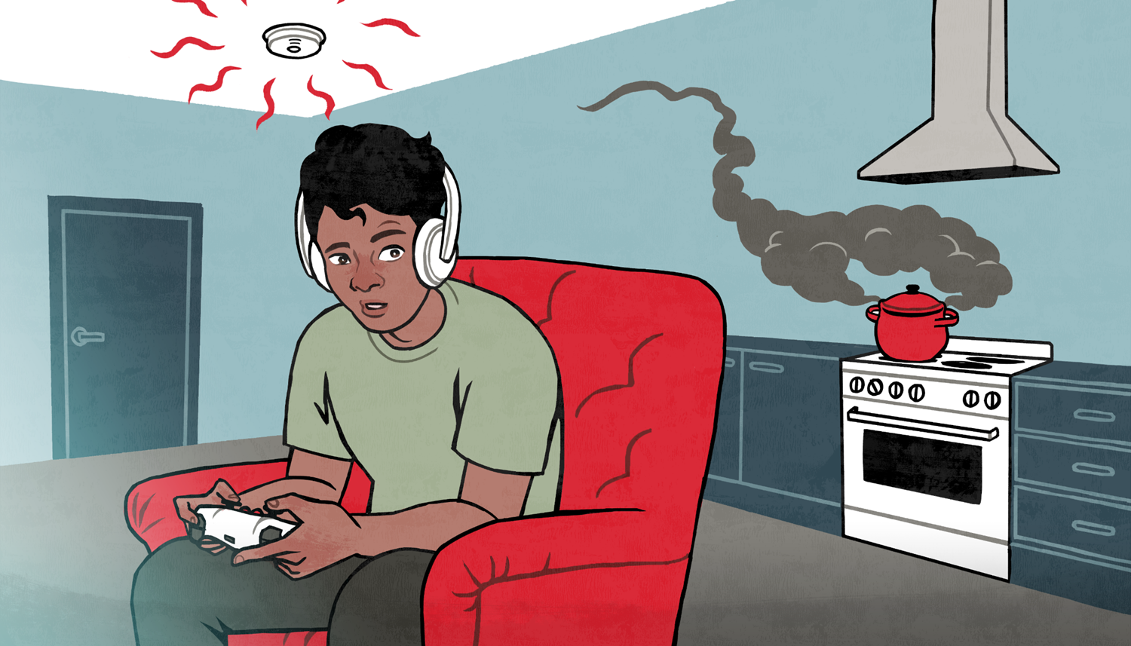
RECAP
LESSON 1:
PREVENTING FIRES

Slide 23
1.
What are the most common causes of fires?
Unattended cooking
Careless use of open fire
Careless heating of a sauna
Electrical appliances
Using a device contrary to the user manual
Using a faulty device

Slide 24
2.
What fire hazards do you know?
Alcohol and drugs + smoking
Untidiness
Heat and dryness

Slide 25
3.
What means to improve fire safety can you take at home?
1. Make sure there are enough smoke alarms.
2. Make sure that smoke alarms are serviced regularly.
Test the alarm once a month
Replace the batteries once a year
Replace the smoke alarm as instructed
3. Charge devices safely.
SAFE PLACE
Notes:
1. Number of smoke alarms:
Minimum requirement: There must be at least one smoke alarm for every 60 m² of each floor.
Recommendation: Smoke alarm for all rooms where people sleep and in the hall after the front door.
2. Make sure that smoke alarms are serviced regularly.
Test the alarm once a month
Replace the batteries once a year
Replace the smoke alarm as instructed
3. Rule of thumb for charging devices: Right place
Instructions: Always charge the battery according to the user manual.
Unplug: Unplug the charger from the device and wall socket when charging is complete.
Overheating: Supervise the charging. Stop the charging if the device overheats.
Condition: Check the condition of the battery and charger before charging. Remove a faulty battery or charger from service without delay.
Authenticity: Beware of risky counterfeit products. Only use suitable CE-marked chargers.
PLACE: Do not charge a battery in places having flammable material nearby, such as in the bedroom.

Slide 26
Self assessment
The self assessment does not affect your grade, but helps us develop the lessons.
Go to the self assessment at: bit.ly/nouhata1 or with the QR code

Slide 27
www.nouhata.fi

